Slide 1


Automated Software Transplantation for Procedural Content Generation
Mar Zamorano, Daniel Blasco, África Domingo, Carlos Cetina, Federica Sarro
maria.lopez.20@ucl.ac.uk

Slide 2
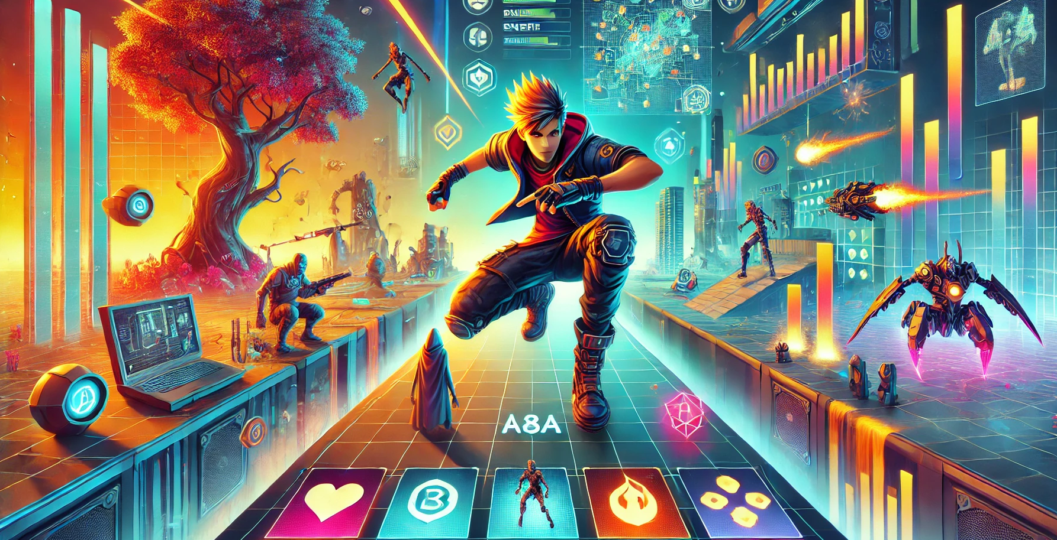

Slide 3
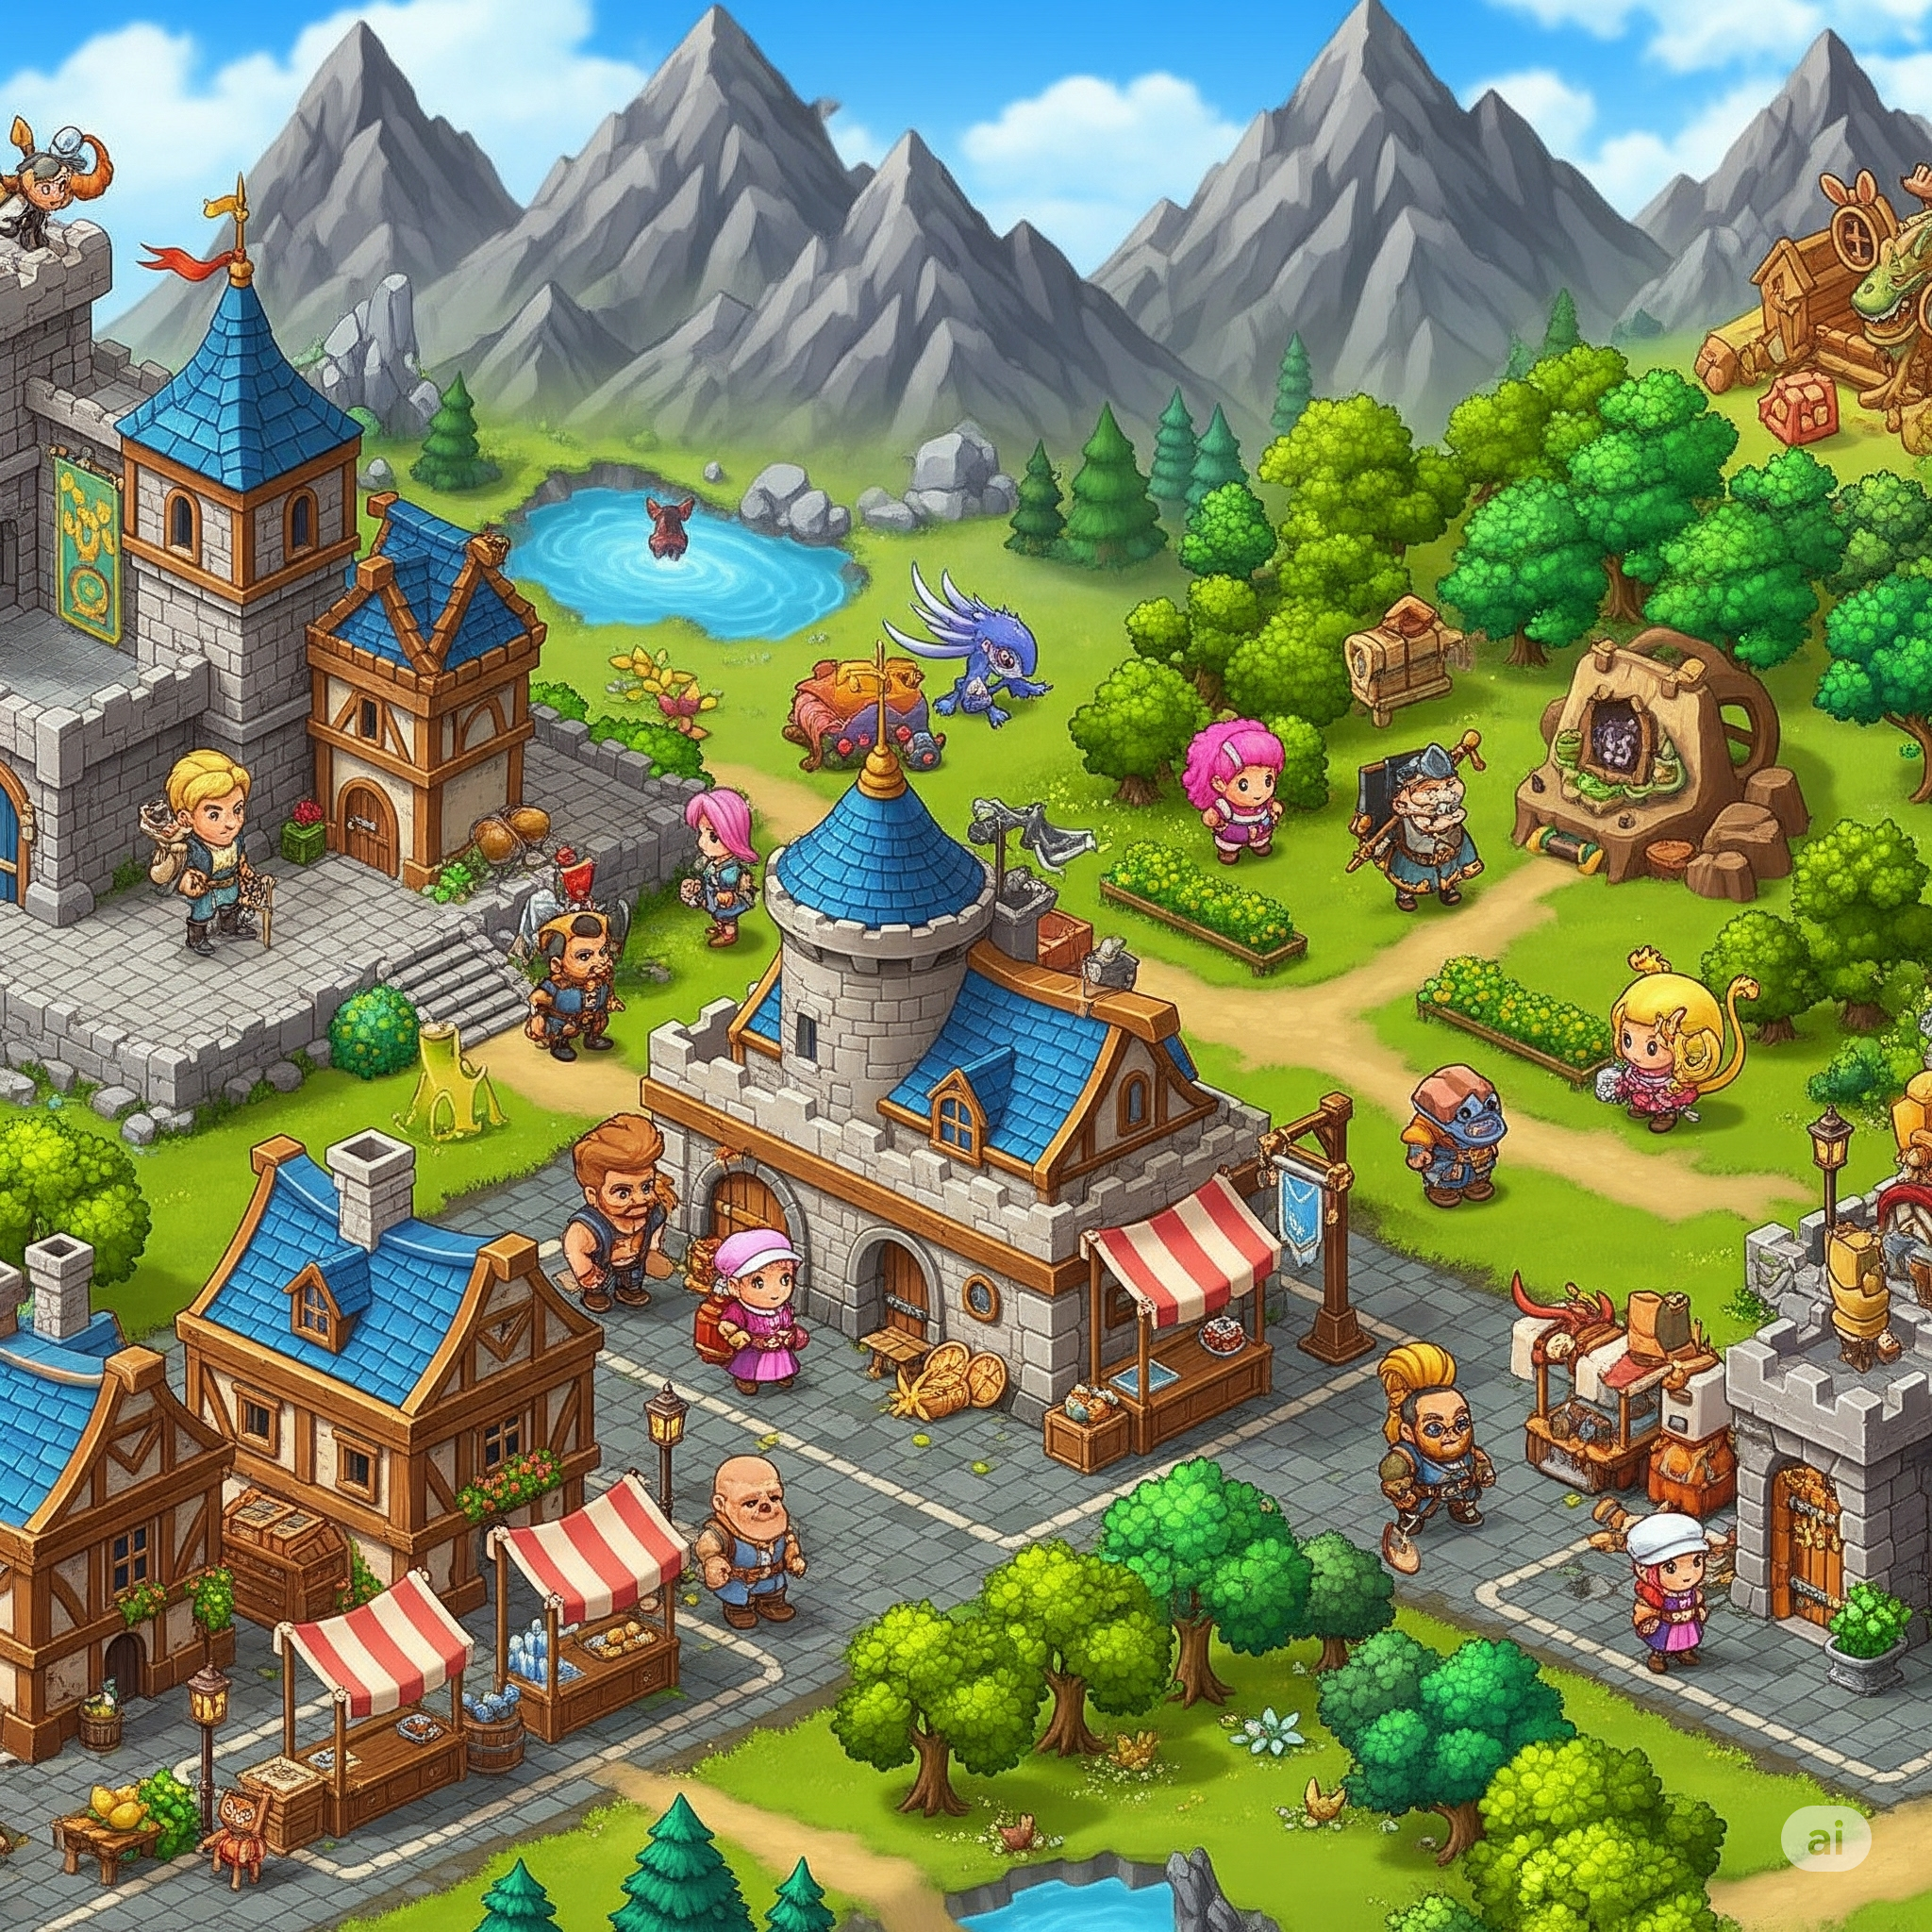

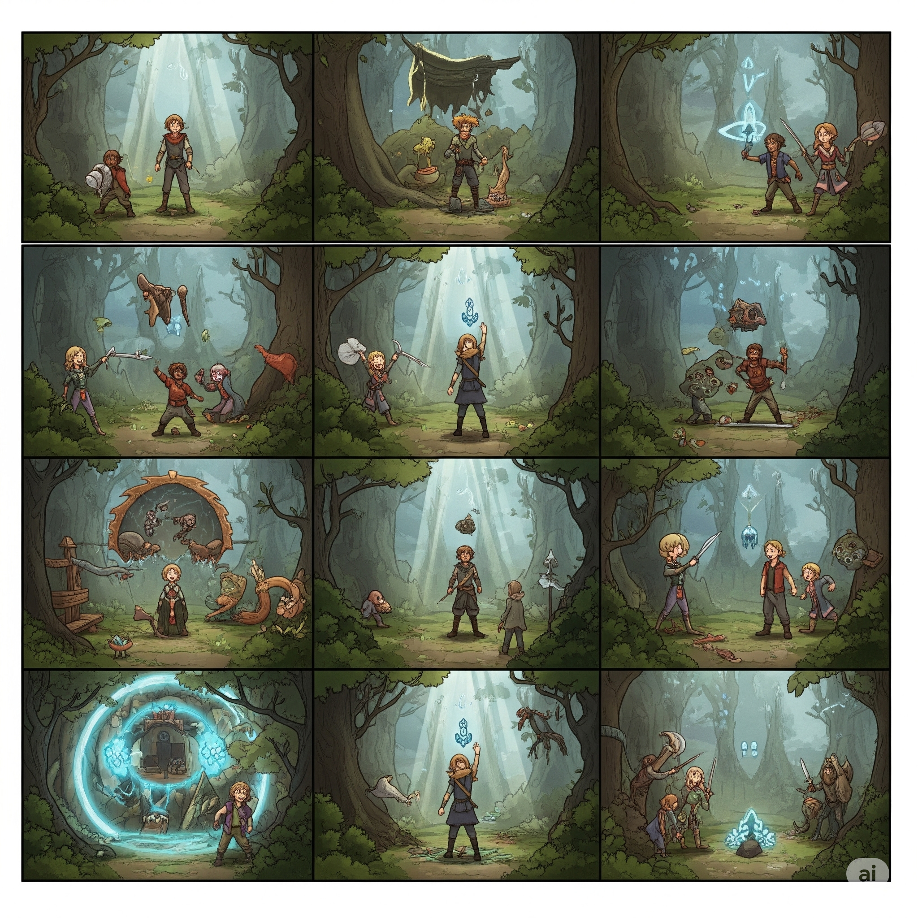

What does videogames need?

Slide 4

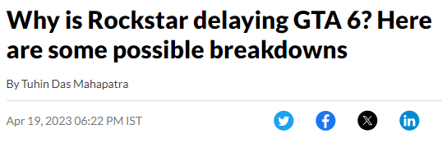


What happens next?

Slide 5


Slide 6

How can we help developers?
Procedural Content Generation (PCG)
Human Generated Content
Procedural Content Generated
Algorithm

Slide 7
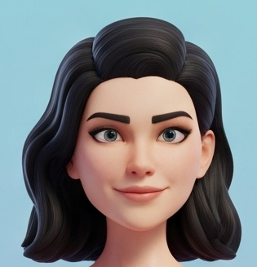

What if…?
Reusing content!!!

Slide 8
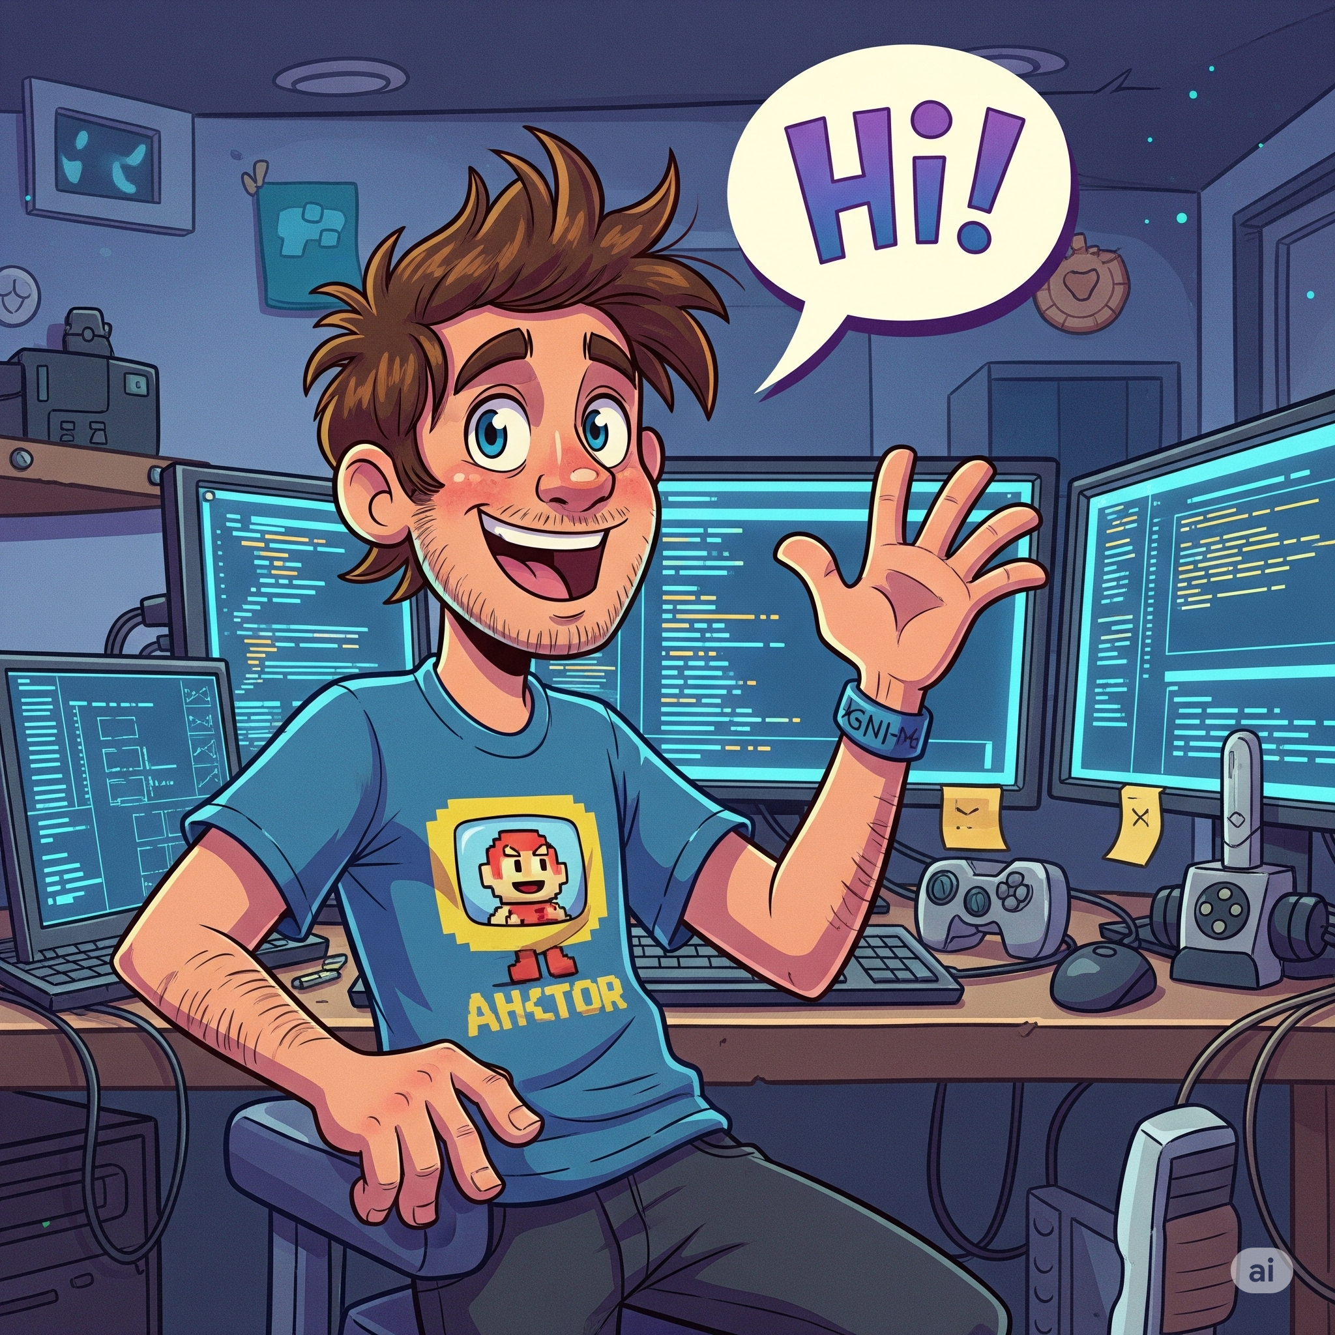
Our Approach: IMHOTEP
Human Generated Content
Procedural Content Generated
PCG
Algorithm
Human Generated Content
Procedural Content Generated
IMHOTEP
Developer
Our
Algorithm

Slide 9
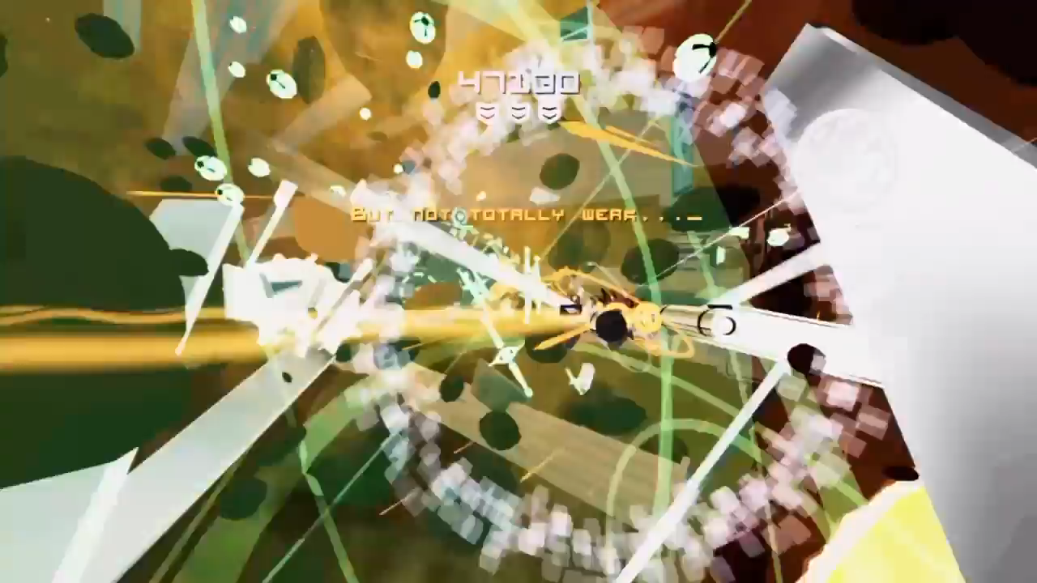
Kromaia

Slide 10


Slide 11
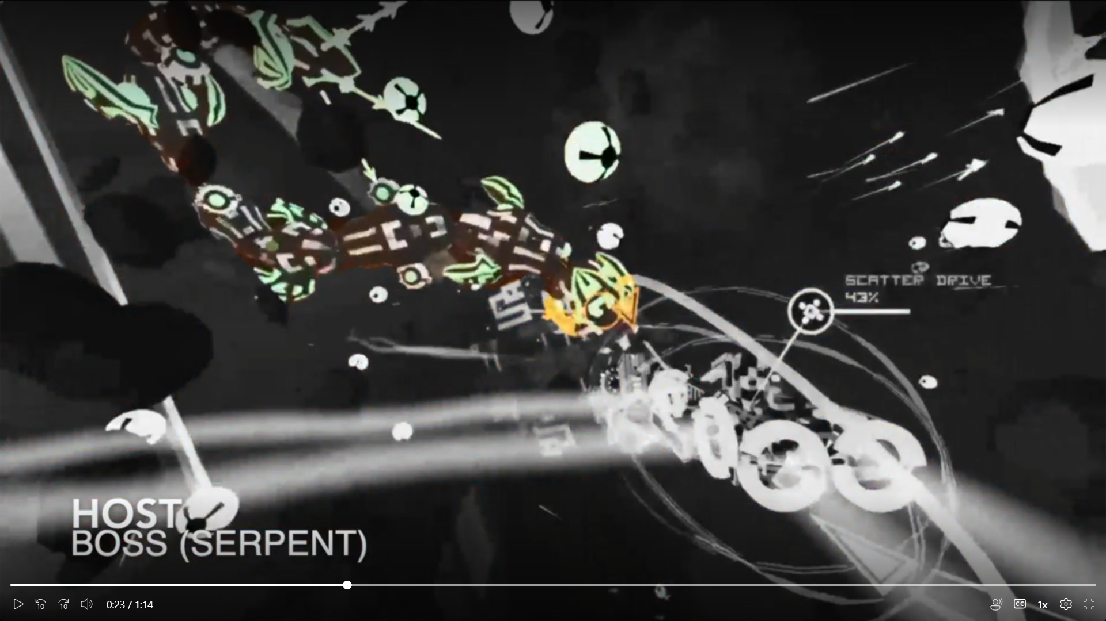
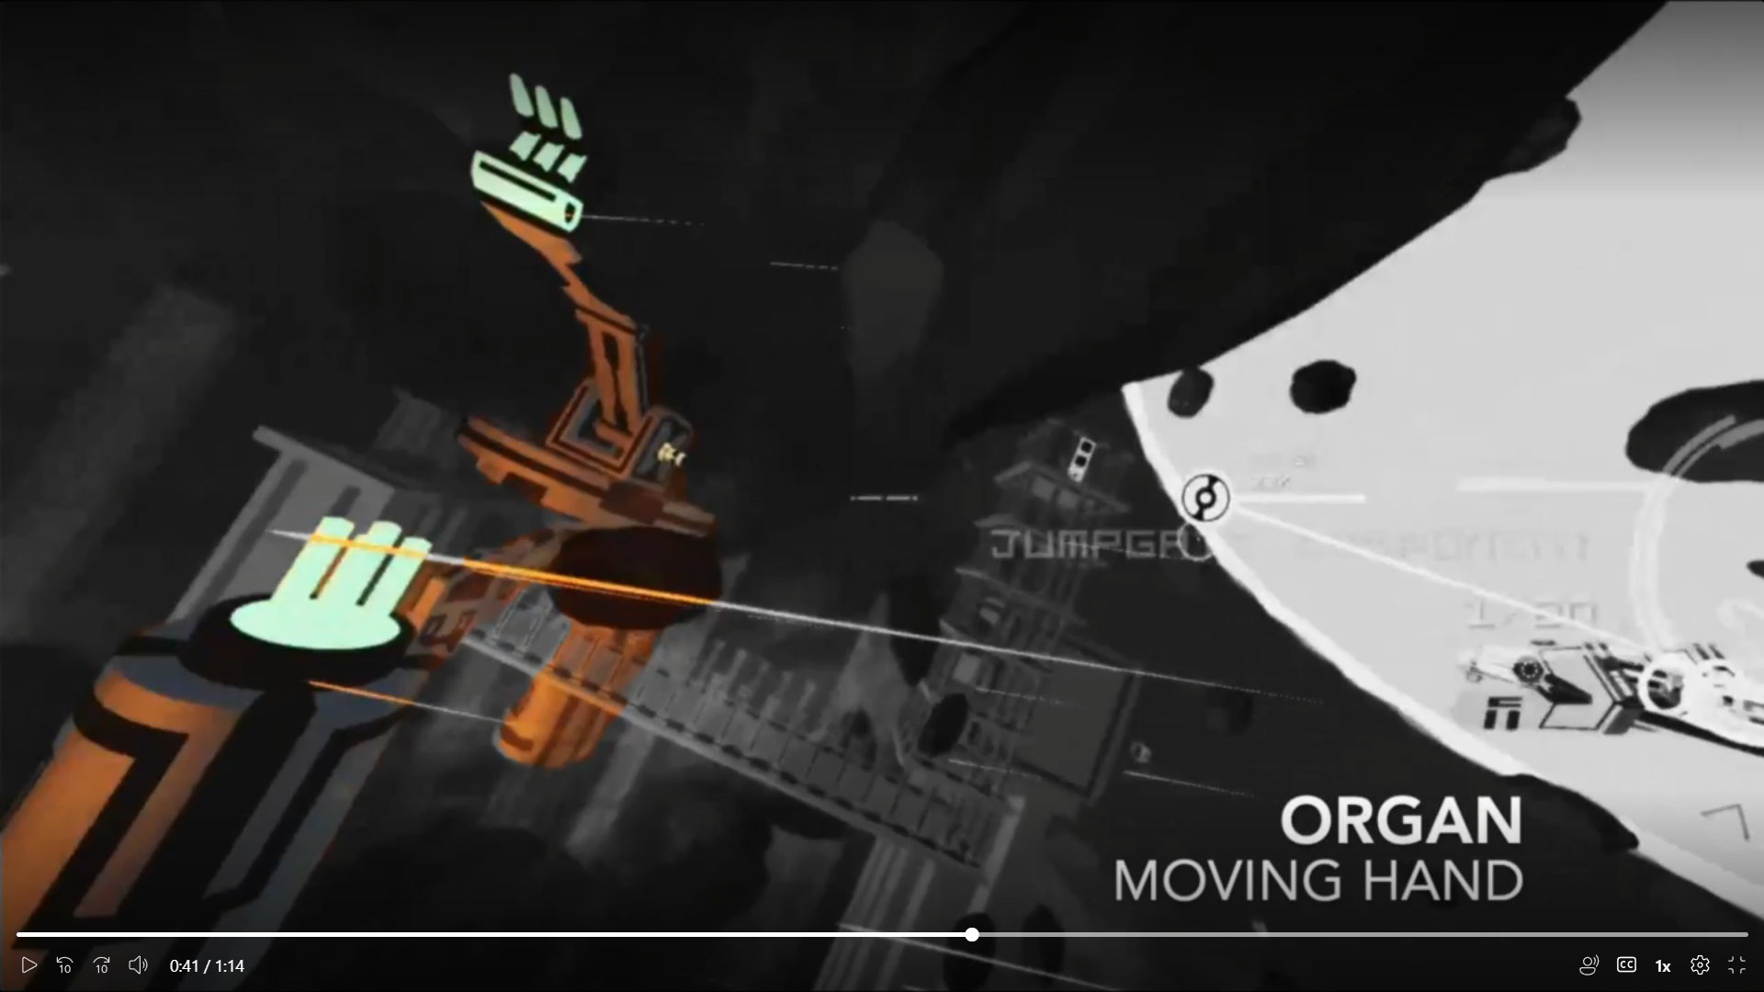
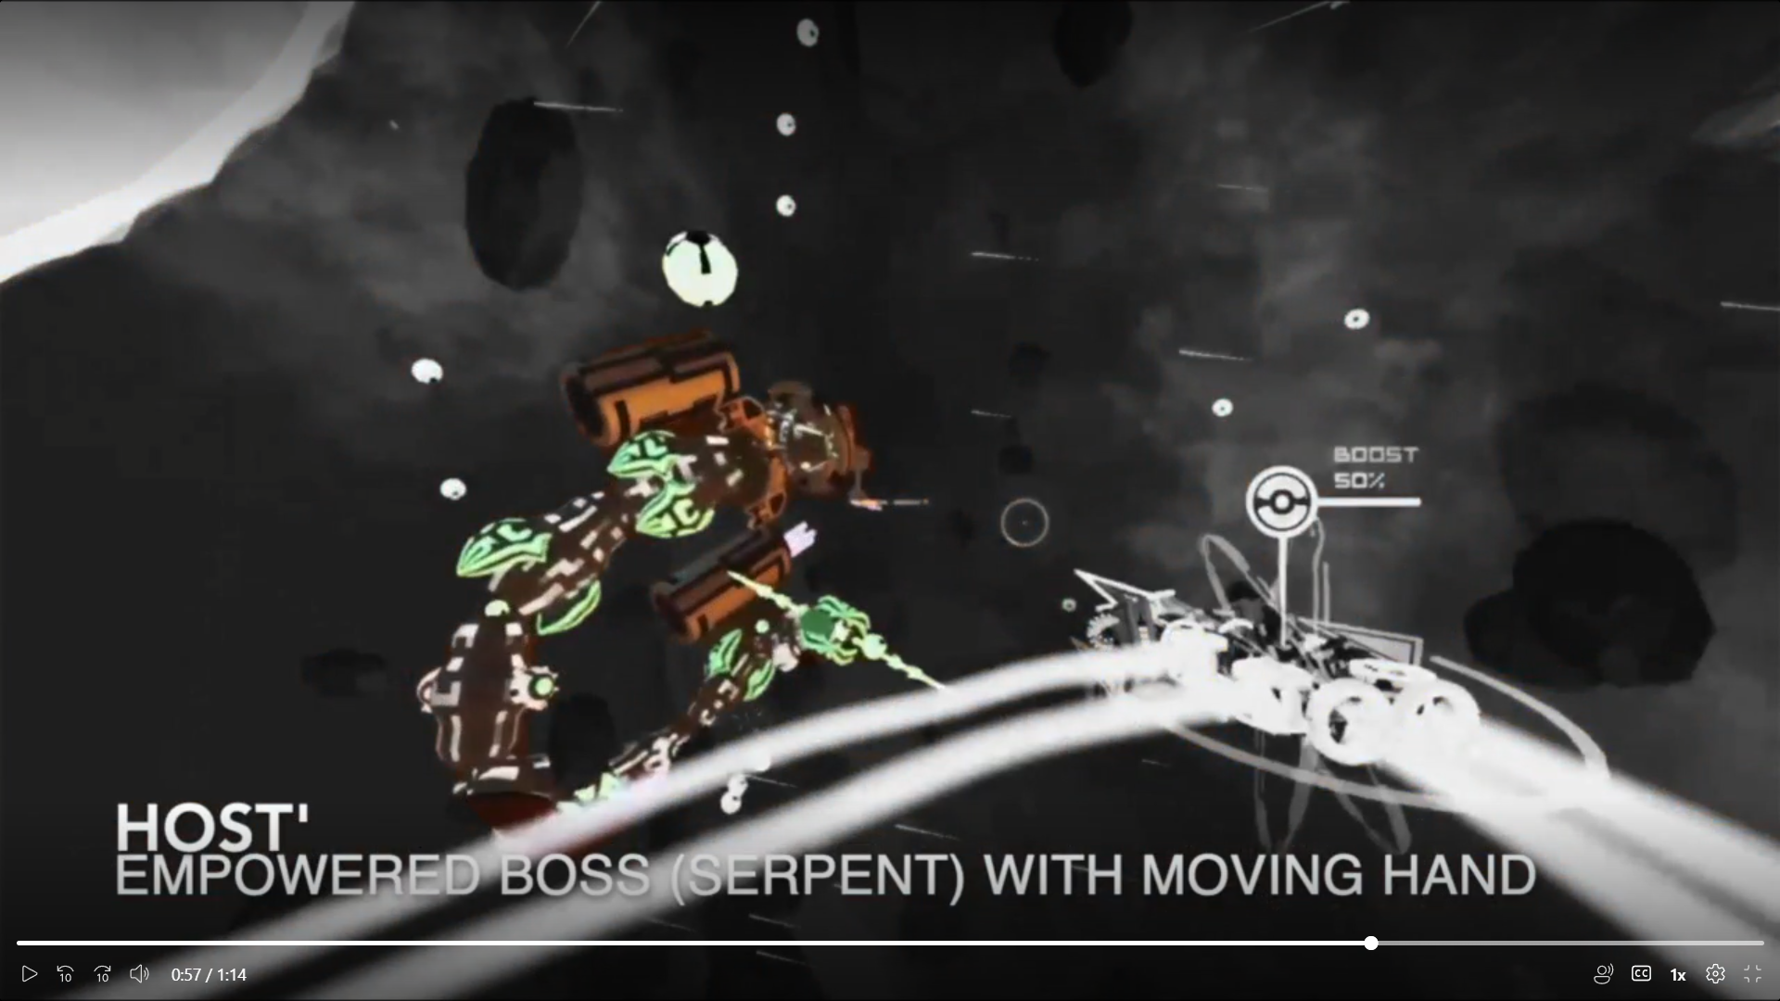
Empirical Evaluation
IMHOTEP (Tests)
IMHOTEP (Simulation)
Baseline
HOST
ORGAN
HOST’
5 different Host
Bosses from Kromaia
(e.g Serpent)
129 different Organs
Elements from the scenario
(e.g. Moving Hand)
645 different Host’
Transplantation between
Host and Organ

Slide 12
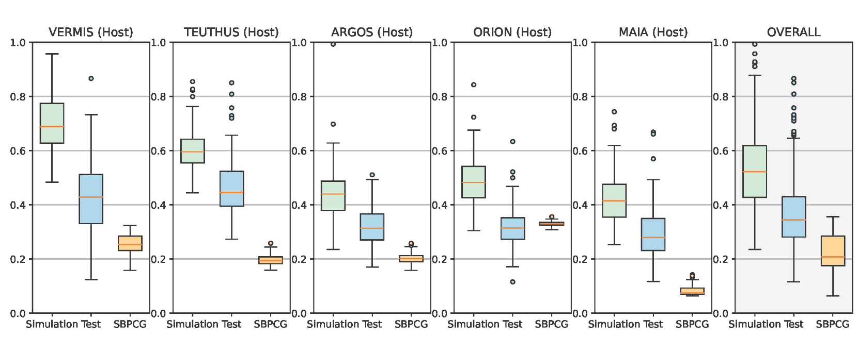
Empirical Evaluation - Results
IMHOTEP (Simulation) vs Baseline → 2.5× ↑↑↑
IMHOTEP (Simulation) vs IMHOTEP (Tests) → 1.5× ↑↑↑

Slide 13
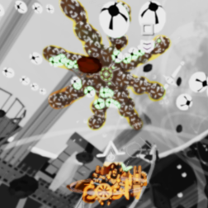
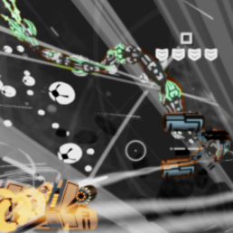


Controlled Experiment
TASK 1
TASK 2
PCG
IMHOTEP
GRUPO A
IMHOTEP
PCG
GRUPO B

Slide 14

Controlled Experiment - Results
IMHOTEP
QUALITY

Slide 15
Criteria Satisfied by Our Work
(B) The result is equal to or better than a result that was accepted as a new scientific result at the time when it was published in a peer-reviewed scientific journal.
(D) The result is publishable in its own right as a new scientific result independent of the fact that the result was mechanically created.
(E) The result is equal to or better than the most recent human-created solution to a long-standing problem for which there has been a succession of increasingly better human-created solutions.

Slide 16
Why should we win?
IMHOTEP redefines the potential of evolutionary algorithms.
It doesn’t just automate; it co-creates with human developers.
It improves developer productivity and enhances the player experience.
It has been validated by academia, by industry, and by those who will actually use it.
We believe this is exactly the kind of breakthrough that the Humies aim to celebrate.

Slide 17


Thanks!
Contact:
Mar Zamorano
maria.lopez.20@ucl.ac.uk
Publications:
- Video Game Procedural Content Generation Through Software Transplantation.
ICSE SEIP 2025.
- Game Software Engineering: A Controlled Experiment Comparing Automated Content Generation Techniques.
ESEM 2024 (Best Paper Award).
ICSE 2025
ESEM 2024

