Slide 1

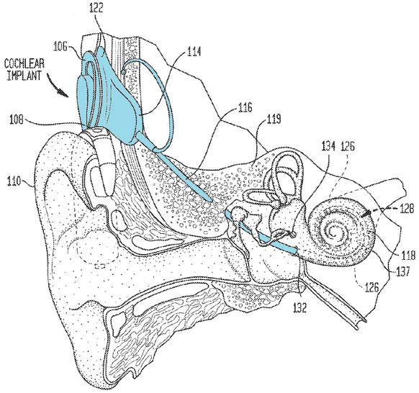
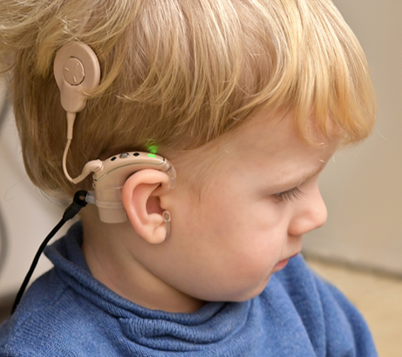
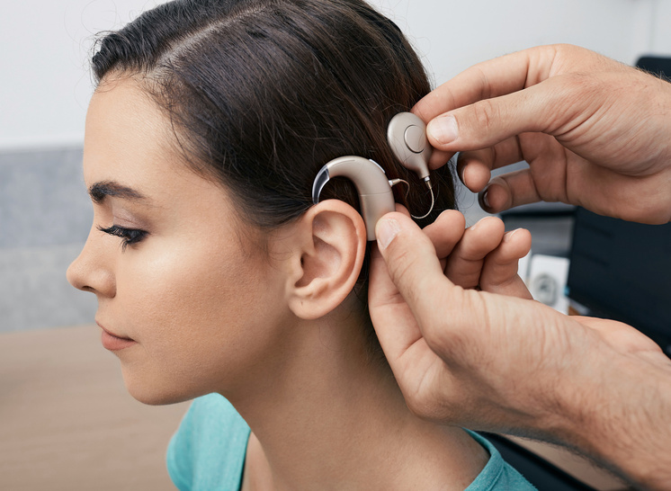
A Computational Model for Multiobjective Optimization of Multipolar Stimulation in Cochlear Implants: An Enhanced Focusing Approach
Institute of Intelligent Systems and Numerical Applications in Engineering SIANI – Univ. of Las Palmas de Gran Canaria ULPGC
Department of Otolaryngology, Complejo Hospitalario Universitario Insular Materno Infantil de Gran Canaria
Las Palmas de Gran Canaria, Spain
M. Hernández-Gil, A. Ramos-de-Miguel, D. Greiner*, D. Benítez, A. Ramos-Macías, J.M. Escobar
Expert Systems with Applications - https://doi.org/10.1016/j.eswa.2025.127472
Source: US Patent 2023/0082528 A1, assigned to Cochlear Limited & Macquarie University (AU)
Notes:
Good afternoon, it is an honor to be here on behalf of the authors of this research work, whose ultimate goal is to improve multipolar stimulation strategies for cochlear implants, enhancing the hearing and quality of life of implanted patients.
A cochlear implant is a surgically implanted medical device that provides a sense of sound to individuals with severe to profound sensorineural hearing loss, stimulating the auditory nerve directly.

Slide 2
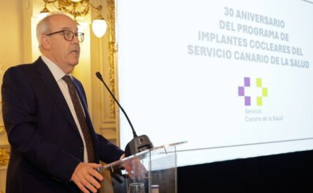
About Cochlear Implant Practice
Main companies in the Cochlear Implant Worldwide market:
Cochlear® Ltd. (more than 60%), MED-EL, Advanced Bionics, etc.
Currently 100,000 implanted patients worldwide every year
Source: https://rtvc.es/se-cumplen-30-anos-del-programa-de-implantes-cocleares-del-hospital-insular-de-gran-canaria/
Notes:
The major multinational companies in the global cochlear implant market are: Cochlear® Ltd. (covering more than 60% of the market), MED-EL and Advanced Bionics. Approximately 100,000 people are implanted each year.
In Spain, the first pediatric patient was implanted in Las Palmas de Gran Canaria in 1994. Since then, more than 1600 patients have been implanted there, led by the Head of the Department of Otolaryngology, Dr. Angel Ramos Macías, co-author of this work.

Slide 3
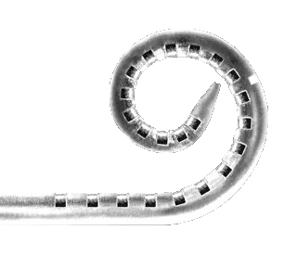
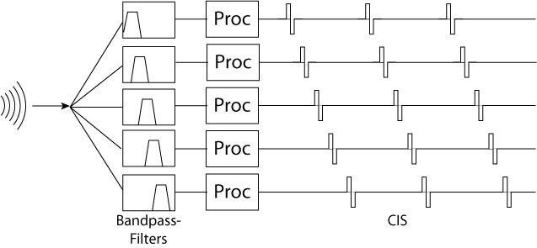
Electrode Stimulation Strategies
Electrode array
Electrode Stimulation Scheme
Electrode
Thomas Haslwanter, CC BY-SA 3.0 via Wikimedia Commons
Notes:
What actually stimulates the auditory nerve is the electrode array, (left figure) which is inserted into the cochlea. This array contains a series of metallic contacts (electrodes), which are placed along the cochlea, following its organization in frequencies.
As in the right figure, the sound is broken down into different frequency bands, each of which is assigned to a channel.

Slide 4
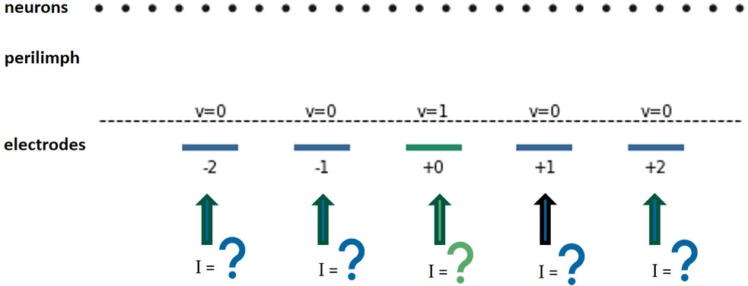
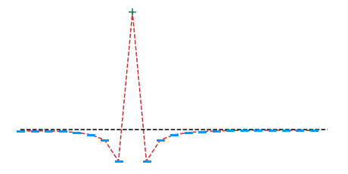
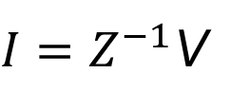
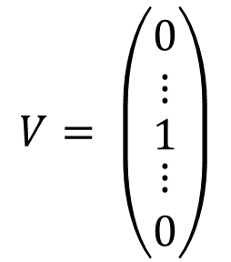
Electrode Stimulation Strategies
Z: Transimpedance Matrix (patient dependent and clinically measured)
Monopolar Stimulation
Phased Array - Multipolar Stimulation
$$V= \left(\begin{matrix}\begin{matrix}0 \\ ⋮\end{matrix} \\ 1 \\ \begin{matrix}⋮ \\ 0\end{matrix}\end{matrix}\right)$$
$I=Z^{−1}$V
Input: Current Intensities
Input: Current Intensities
Current intensities profile
Notes:
In any stimulation strategy to configure the cochlear implant, the relationships between the intensities and voltages of the implant electrodes must be measured, which allows the Z- transimpendance matrix to be obtained clinically.
In Monopolar Stimulation, the most common strategy, each channel is associated with a single electrode (in green in the left cochlea), which is simple. Electrical current is delivered only from the primary active intracochlear electrode to an extracochlear ground.
Its major limitation is that the greater dispersion of excitation results in less precise stimulation of auditory nerve fibres. This may reduce frequency resolution, and speech perception in noisy environments.
In Multipolar Stimulation, each channel is associated with a set of electrodes (in green and blue in the right cochlea).
As main advantages, this results in more focused stimulation with better pitch resolution and potentially better speech understanding in noise or music perception; and reduced interaction between channels. As a limitation, higher power consumption is needed.
The state of the art of multipolar stimulation is phased array, where the currents injected into the electrodes allow a non-zero electrical potential value to be obtained at the primary active electrode and zero at the rest, as shown in the right scheme. From the inverse transimpedance matrix, the above calculation is straightforward.

Slide 5

Finite Element Method Conductive Model
Description
Laplace equation:
$$∇\left(σ∇φ\right)=0$$
Being σ electrical conductivity (σ_{ext}: sphere, σ_{bone}: cortical bone, σ_{per}: perilinph) and ϕ the potential.
Notes:
We will use a Finite Element Model (FEM) to calculate the electrical current densities at the location of the neurons, to be able to determine the focusing of each stimulation strategy.
The FEM model is governed by Laplace's equation, being sigma the electrical conductivity and phi the electrical potential. The geometries involved are (left figure): a surrounding sphere, the cochlea, and the reference electrode; and continuing in the right zoomed figure, the virtual neurons, and the electrode array with the electrodes (in red).
The conductivities of sphere, cortical bone and perilimph will be adjusted to produce a model match of the clinically measured transimpedance matrix, as explained next.

Slide 6
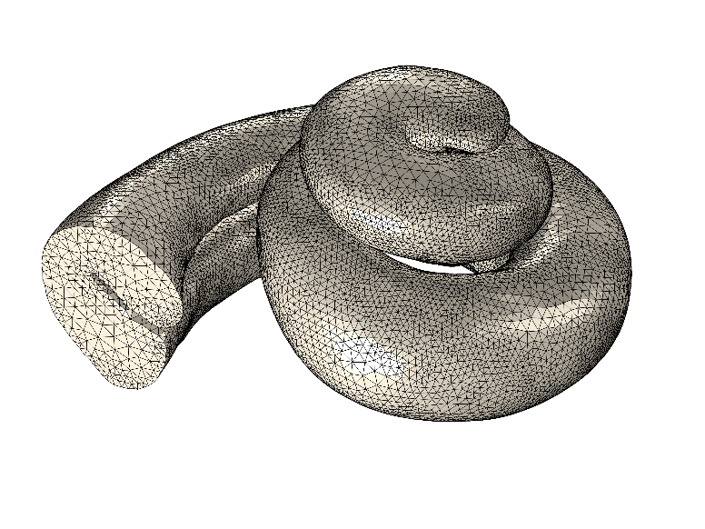
Finite Element Method Conductive Model
Fitting measured Patient Transimpedance Matrix
Fitted FEM Model in order to match:
  Clinically measured Transimpedance Matrix, with
  FEM simulated Transimpedance Matrix Zc
Surrogate assisted (Kriging) Differential Evolution:
Genes: σ_{ext}, σ_{bone}, σ_{per}
Objective Function (ObF): Frobenius norm of Matrices (22x22) differences
Optimum Fitted FEM solutions
Notes:
The FEM is fitted using a Kriging surrogate assisted differential evolution. The genes of the chromosome are the values of the 3 conductivities and the objective function to minimize consists in the Frobenius norm of the difference of the clinical and FEM transimpedance matrices. The table shows the optimal conductivity values and mean errors per matrix input in the two tested cochleae, which allow an efficient fit of the FEM model to the clinical data.

Slide 7
Finite Element Method Conductive Model
Usefullness
Computing current density distribution at neuron positions:
Input of the FEM model:
α normalized current intensities at electrodes (22)
Output of the FEM model:
current density distribution at neuron positions (151)
Notes:
The usefullness of the FEM model lies in calculating the current density distribution at the location of the neurons, taking as input the normalized electric current intensities at each of the 22 electrodes, and giving as output the normalized maximum electric current density distribution at the locations of the 151 neurons. The case of monopolar stimulation is shown.

Slide 8
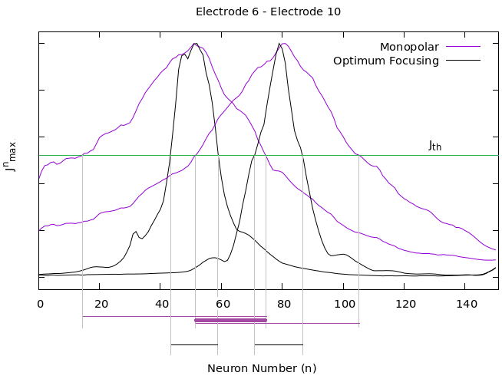

Finite Element Method Conductive Model
About Focusing and Crosstalk
The greater the focusing, the less interaction between channels (less crosstalk), and therefore expected higher hearing resolution and auditory quality.
Notes:
The greater the focusing, the less interaction between channels (less crosstalk), and therefore expected higher hearing resolution and ultimately auditory quality.
A current density profile with a steeper decrease as we move away from the target neurons indicates greater focusing than another profile with a gentler decrease.
Thus, in the figure for a given threshold current density level j (green horizontal line), the violet signals show crosstalk, as seen in the lower violet horizontal line, while the more focused black signals do not.

Slide 9
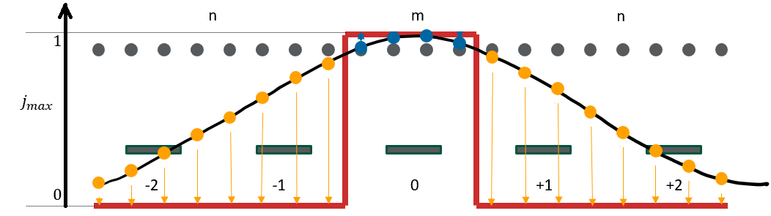


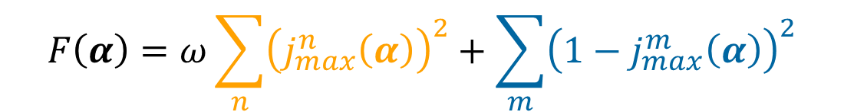
Multiobjective Optimization: Objective Functions
Input: $α=$ vector of normalized currents at electrodes (22)
Distribution m / n of neurons is partitioned according to their nearest proximity to each electrode.
Objective Function 1: Minimize Dispersion F, OR equivalently, Maximize Focusing Fc
$$F\left(α\right)=ω\sum_{n}{{\left(j_{max}^{n}\left(α\right)\right)}^{2}}+\sum_{m}{{\left(1−j_{max}^{m}\left(α\right)\right)}^{2}}$$
$$F_{c}\left(α\right)=F_{max}−F\left(α\right)$$
Objective Function 2: Minimize Power Consumption P
$$P\left(α\right)=α^{T}Z_{c}α$$
Notes:
Both maximizing focusing and minimizing power are objectives in conflict of a multi-objective optimization.
The design variables are the vector of normalized electrical currents at each of the electrodes.
The location space of the virtual neurons is partitioned, assigning each to the electrode with its closest position. Ideally, each electrode will stimulate only the region of m neurons closest to it.
The first objective function to minimize is the dispersion F, which consists of the sum of the differences between the current density distribution generated by the FEM, jmax (curved black line in the figure), and the ideal (red line in the figure). Those differences are represented by the yellow and blue lines and terms. As an alternative to minimizing the dispersion F, the maximization of focusing Fc is formulated.
The second objective function to minimize is the power consumption.

Slide 10
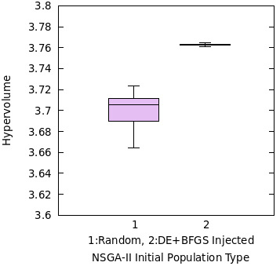
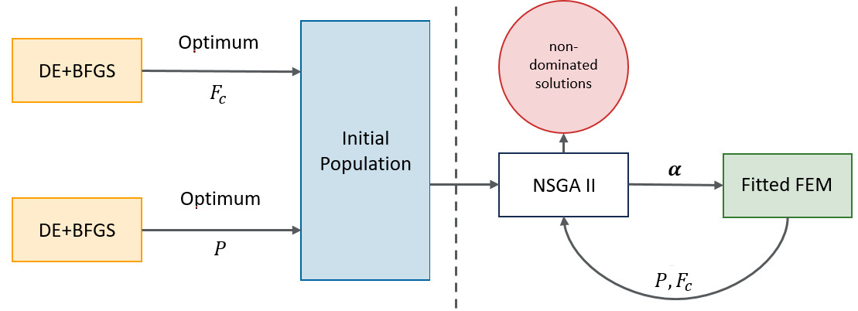
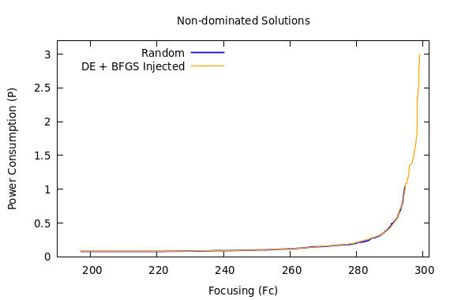
Multiobjective Optimization: DE+BFGS Injected NSGA-II
Median non-dominated front (out of 21 executions)
Notes:
The multi-objective optimization is solved using an NSGA-II with the optimal solutions of each objective function inserted into the initial population. These are obtained by a hybrid differential evolution combined with a deterministic quasi-Newton optimization (BFGS).
As in the top right figure, the hypervolume distribution achieved in 21 independent runs is statistically significantly larger in the proposed algorithm than in the standard NSGA-II. The bottom figure shows the median front and illustrates how this is achieved by obtaining extended fronts in the top right area, corresponding to optimal focusing solutions.

Slide 11
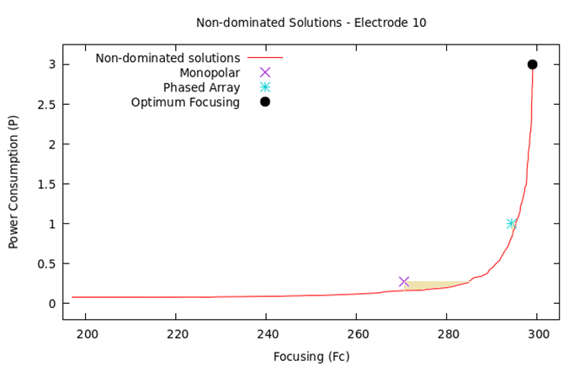
Results: Non-dominated Front
Phased Arrray channels, first published in:
Van den Honert, C., Kelsall, D. (2007) "Focused intracochlear electric stimulation with phased array channels", The Journal of the Acoustical Society of America, Vol. 121, 3703-3716. https://doi.org/10.1121/1.2722047
Notes:
In the figure, the search direction is directed toward the lower right corner.
The red line represents the non-dominated solutions, providing the lowest solution in terms of power consumption for each focusing value, or, the highest solution in terms of focusing for each power consumption value.
However, the state-of-the-art solutions, both monopolar stimulation (pink X) and phased-array stimulation (light blue asterisk, whose publication reference is detailed), are dominated (worse) solutions.
Consequently, criteria B and F of the Humies competition are met: we found solutions that simultaneously improve both objective functions, focusing and power (under the yellow shaded areas).
The black dot represents the maximum focalization. Its details in terms of current density distribution at the neuronal locations are shown next.

Slide 12
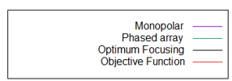
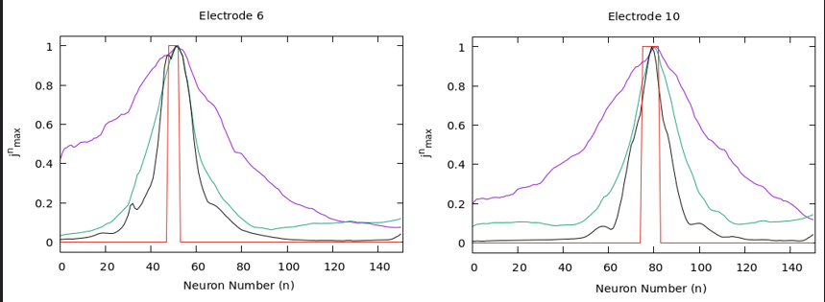
Results: Optimum Focusing – Current Densities
Notes:
The figures show how the monopolar stimulation (pink line) exhibits less focusing than the phased-array stimulation (green line), due to its gentler slopes along the neuronal distribution. However, the optimal focusing represented by the solid black line, excels by achieving the steepest slopes and profiles closest to the desired ideal represented by the solid red line, supporting compliance with criteria B and F.

Slide 13
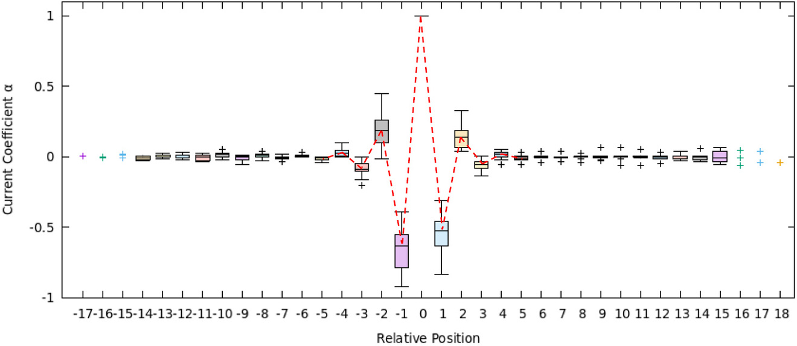
Innovization: Extracting Design Principles
Current profile Median Pattern -----------
“Current profile of Phased Array:
Notes:
In addition to the improvement of the state-of-the-art monopolar and phased array solutions in focusing and power and the obtaining of improved focusing solutions, which would justify compliance with criterion D, useful design principles have also been extracted from the design variables of the maximum focusing.
The right figure was obtained by superimposing the current intensity values ​​of the maximum focusing for all the calculated electrodes, placing the central active electrode at electrode 0 for each case. The distribution of each electrode in its relative position is represented by a box plot, which shows a current pattern with alternating signs and decreasing amplitude. By taking the median value at each electrode, a median pattern is constructed, shown by a dashed red line limited to electrodes -4 to +4.
This pattern improves the focusing of the phased array solution, whose different current pattern is shown below left.

Slide 14
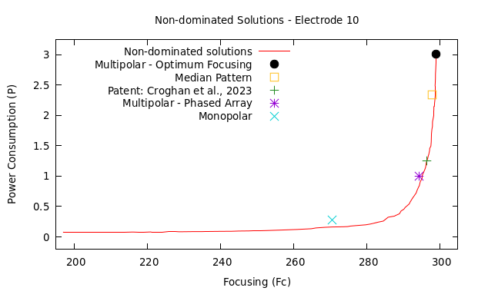
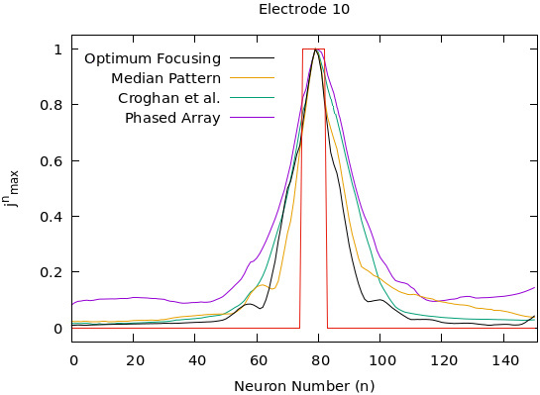
Criterion A – Patent related
Submitted Patent Application, under review:
Hernández-Gil, M., Ramos-de-Miguel, Á., Greiner, D., Benítez D., Escobar, J.M. (2024) "Method and System for Optimizing Multipolar Stimulation in Nerve Stimulation Protheses", Application Number 24382066-EP/9, January 2024.
Notes:
By integrating the median pattern solution that we observed previously in the upper right figure, it lies within the yellow hollow square.
In support of criterion A, this work has led to an European patent application under evaluation since January 2024; its reference is shown below.
Furthermore, we have considered the current distribution profile at the electrodes proposed in a recent patent (Croghan et al., 2023). When represented in the objective function space (green cross), it almost lies on the boundary of the non-dominated solutions (red line).

Slide 15
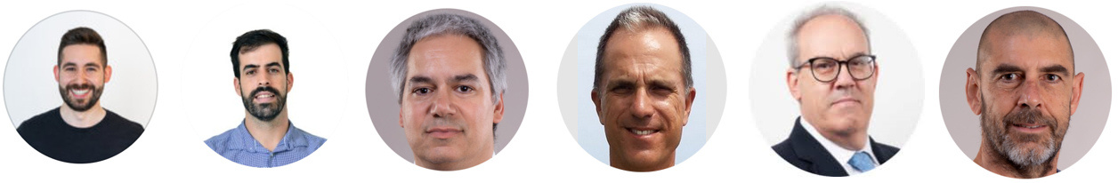


A Computational Model for Multiobjective Optimization of Multipolar Stimulation in Cochlear Implants: An Enhanced Focusing Approach
Institute of Intelligent Systems and Numerical Applications in Engineering SIANI - University of Las Palmas de Gran Canaria ULPGC
Department of Otolaryngology, Complejo Hospitalario Universitario Insular Materno Infantil de Gran Canaria
Las Palmas de Gran Canaria, Spain
M. Hernández-Gil, A. Ramos-de-Miguel, D. Greiner*, D. Benítez, A. Ramos-Macías, J.M. Escobar
Expert Systems with Applications - https://doi.org/10.1016/j.eswa.2025.127472
Acknowledgements of funding support:
  Ministerio de Ciencia, Innovacion y Universidades: PID2019-110185RB-C22 (with support letter from Cochlear® Ltd.)
  ACIISI, Consejería de Economía, Conocimiento y Empleo del Gobierno de Canarias: PROID 2020010022
  Consejería de Universidades, Ciencia e Innovación y Cultura del Gobierno de Canarias: PRECOMP02 SD-24/03
Notes:
We would like to emphasize that the objective of this proposal is to improve the hearing quality of cochlear implant recipients. We hope that some of the solutions achieved here, will soon be used in clinical trials. Applications for funding these trials are currently under review.
For potentially thousands of people, these improvements could mean the remarkable difference between silence … and quality hearing.

