Slide 1


Evolution of Heuristics
Towards Efficient Automatic Algorithm Design using Large Language Model
Zhichao Lu
Fei Liu, Xialiang Tong, Mingxuan Yuan, Xi Lin,
Fu Luo, Zhenkun Wang, and Qingfu Zhang
July 17, 2024

Slide 2











Collaborators from Both Academia and Industry

Slide 3

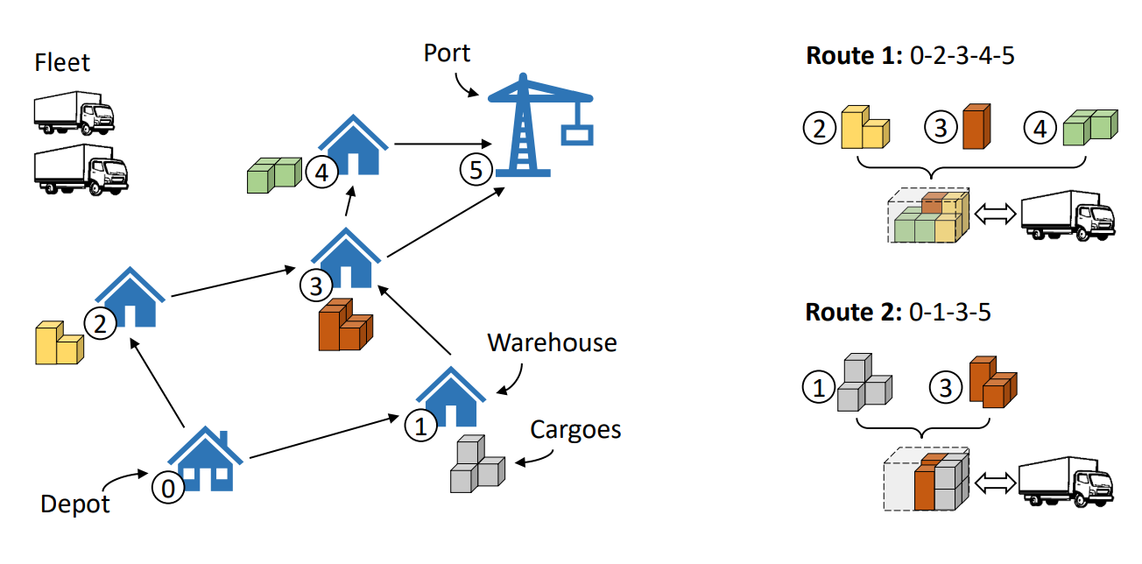
The Crucial Role of Algorithms
Algorithms are vital for solving optimization problems and decision-making tasks
Broad Applications:
Manufacturing & Logistics: Streamlining operations and improving efficiency
Social Media: Enhancing user experience through personalized content
Finance: Optimizing investment strategies and risk management
Gaming: Enhancing AI responsiveness and player engagement
Education: Personalizing learning experiences and outcomes
Agriculture: Maximizing yield and resource management
…
Algorithms on Social Media
Challenges in Algorithm Design:
Traditional methods of designing algorithms require extensive expertise
Often involves a significant amount of trial-and-error
Time-consuming process demanding deep domain knowledge
Algorithms on Logistic and Manufacturing Problems

Slide 4
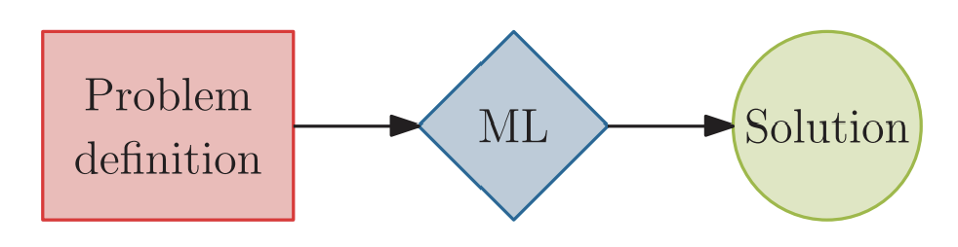
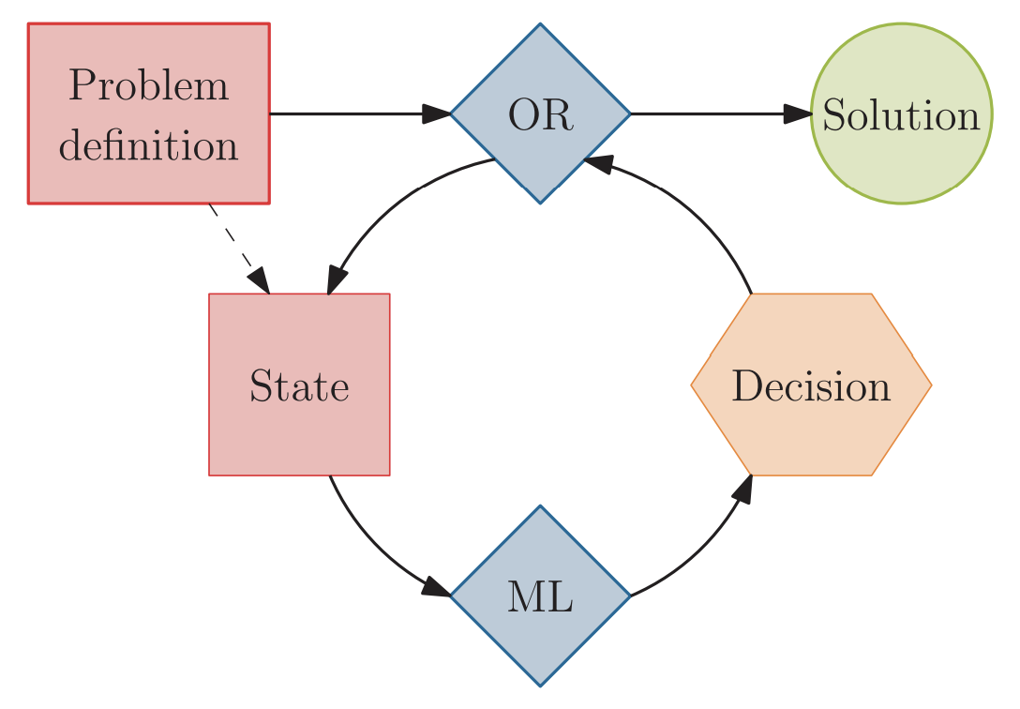
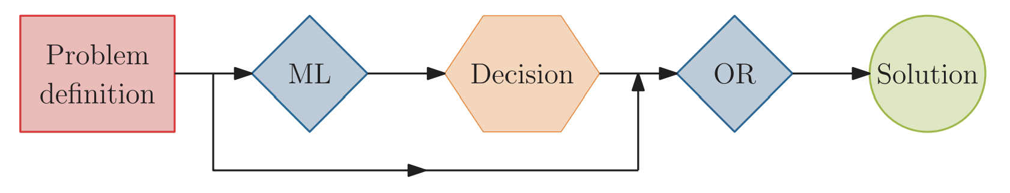
Enhancing Algorithm Design with Machine Learning
Machine learning (ML) techniques are increasingly integral to developing algorithms
a) ML acts alone
Despite their widespread adoption, these methods still depend significantly on expert input and necessitate considerable customization when adapting to new settings or constraints
b) ML augments Alg.
c) ML as decision maker
Bengio, Y., Lodi, A. and Prouvost, A., 2021. Machine learning for combinatorial optimization: a methodological tour d’horizon. European Journal of Operational Research, 290(2), pp.405-421.

Slide 5
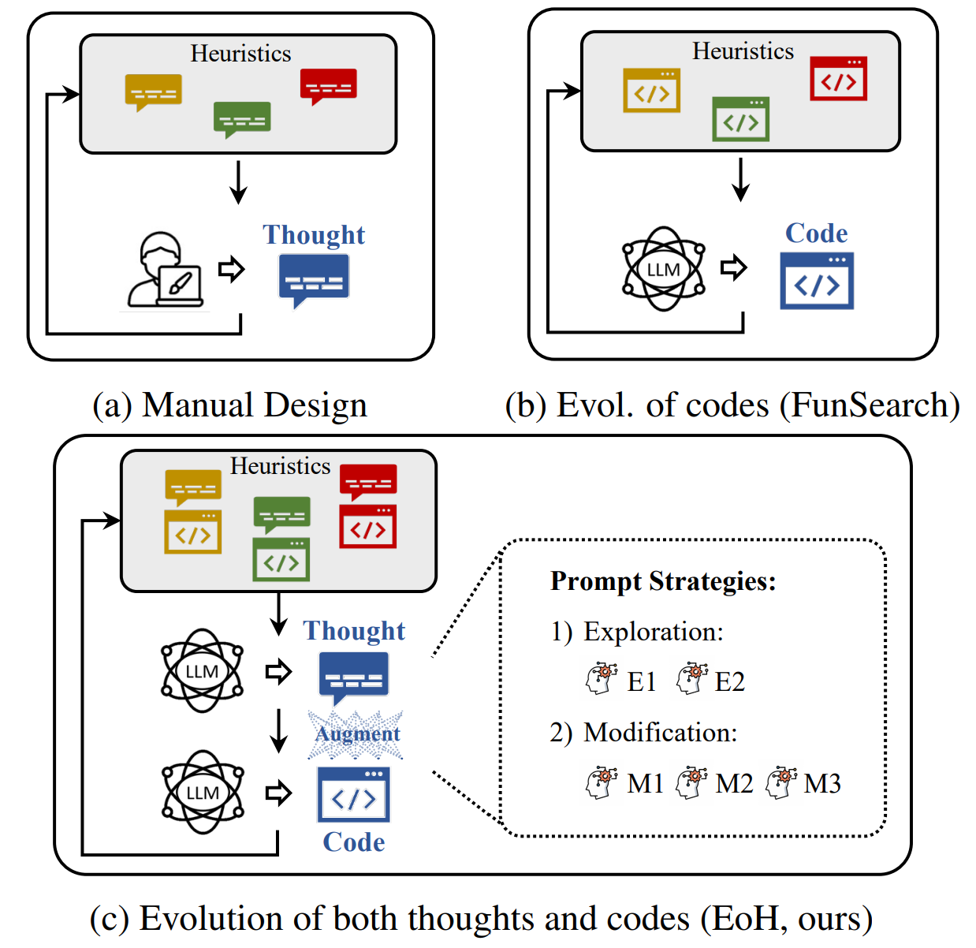
Evolution of Heuristics (EoH) for Algorithm Design
EC + LLM:
Combining Evolutionary Computation (EC) with Large Language Models (LLMs)
From Evolution of Solutions to Evolution of Heuristics:
Transitioning from evolving direct solutions to evolving sophisticated heuristics
Open-endess Heuristic Development:
Heuristics, concepts, and strategies are created, combined, and refined through interaction with LLMs within an EC framework
Automated and Enhanced Problem-Solving:
Leveraging the synergy between EC and LLMs to develop more adaptive, efficient, and robust algorithms

Slide 6


Illustration of EoH Framework
Initialization
Initialization Prompting
Parsing
Population
Management
Heuristic
Heuristic
Heuristic
Heuristic
Heuristic
Heuristic
Heuristic
Evaluation
Selection
Crossover
Heuristic
Crossover
Prompting
Parsing
Heuristic
Heuristic
Heuristic
Mutation
Mutation
Prompting
Parsing
Heuristic
Heuristic

Slide 7
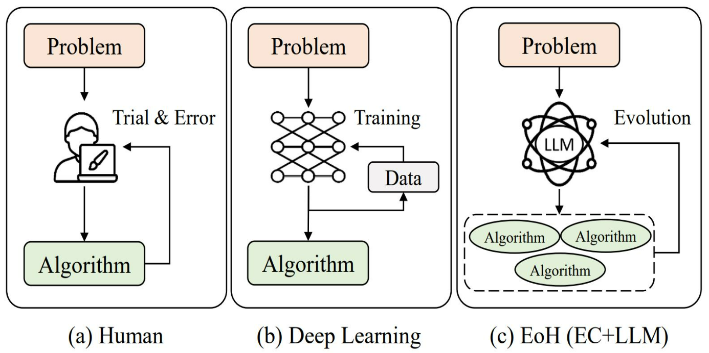
EoH: A Revolutionary Algorithm Design Paradigm
Three Different Approaches for Algorithm Development
Human
(Trial-and-error)
Human + Model
(Model crafting and training)
EC + LLM (EoH)
(Minimum human effort, no model training)

Slide 8
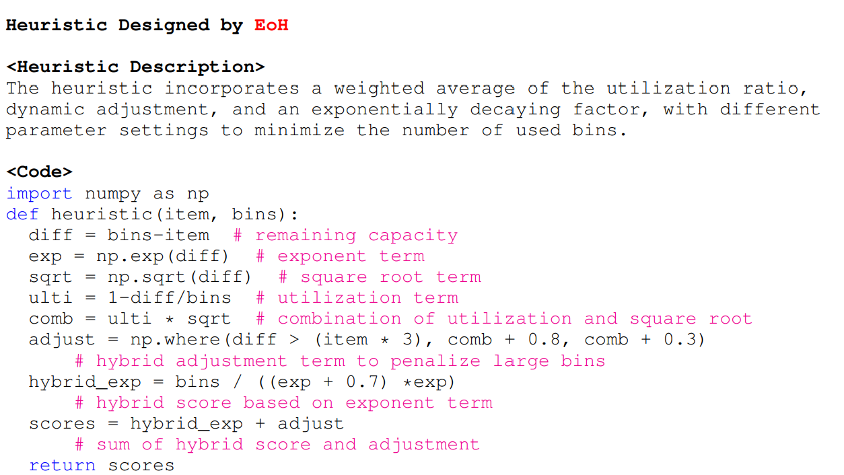
Individual Representation in EoH
A heuristic description (Thought)
In natural language
A code block (Code)
Python code snippet with a predefined function name, specific inputs, and expected outputs
A fitness value
Assessment based on performance across various instances.
An example on online bin packing problem

Slide 9
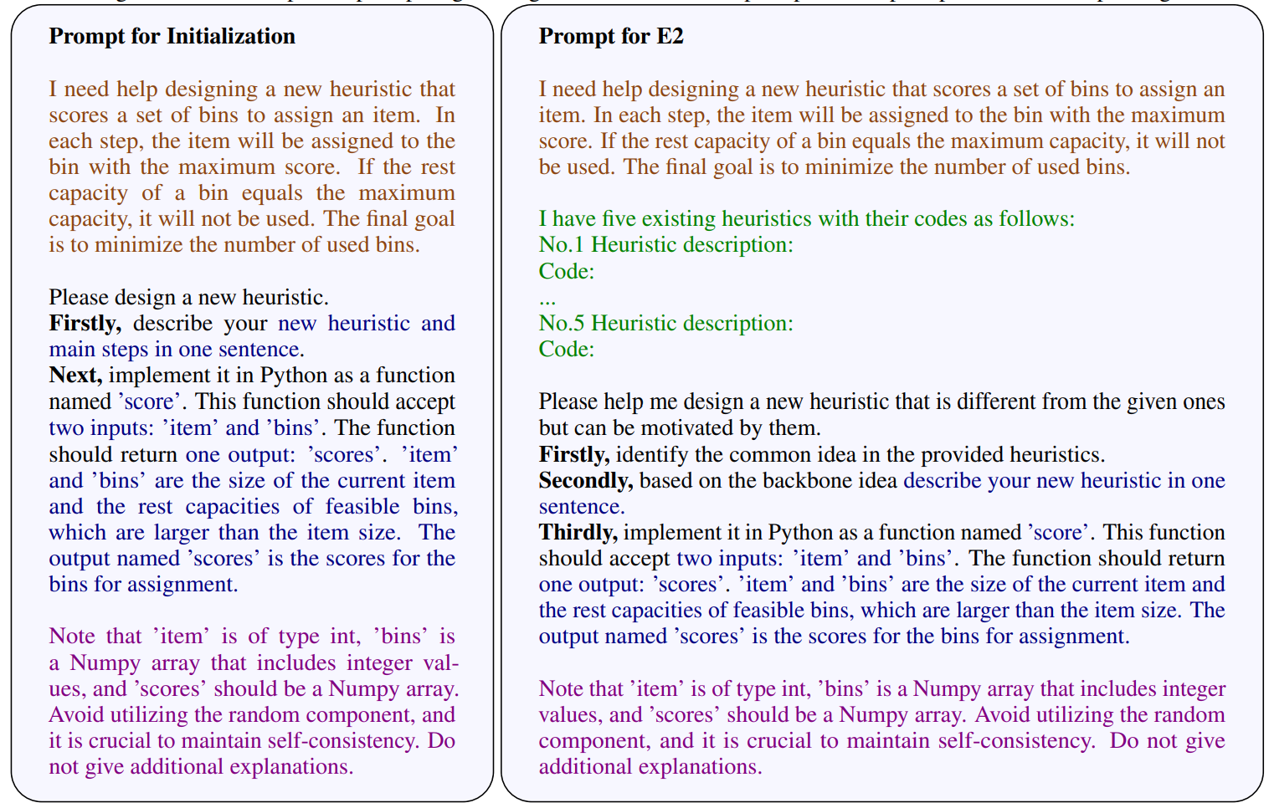
Generate New Heuristic by Prompting LLM
LLM Prompt strategies:
Initialization (I1)
Evolution (E1, E2, M1, M2, S1)
Prompt consists of five components:
A description of the task
Parent heuristic(s)
Operator-specific prompts
Expected outputs
Notes

Slide 10
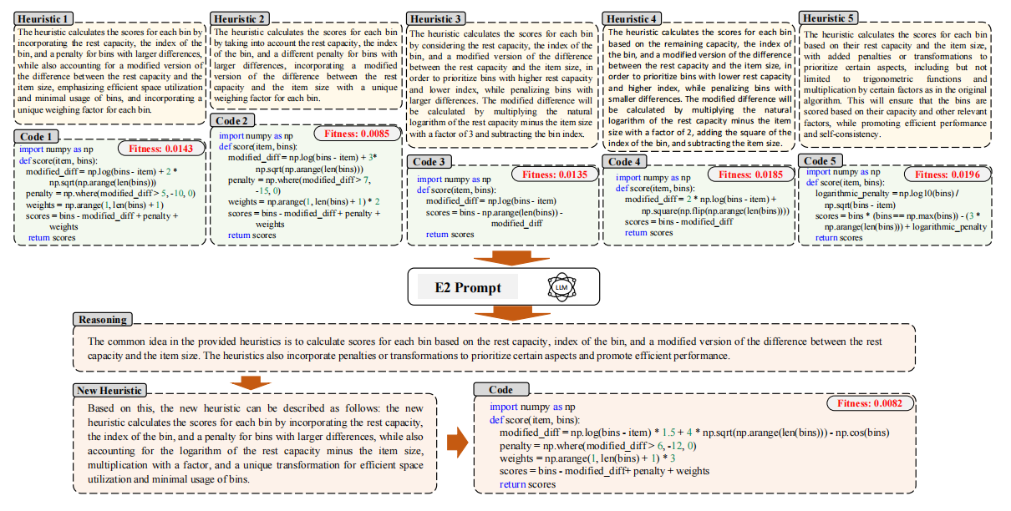
Illustration of Heuristic Generation in EoH on Online BP
Fei Liu, Xialiang Tong, Mingxuan Yuan, Xi Lin, Fu Luo, Zhenkun Wang, Zhichao Lu, and Qingfu Zhang, “Evolution of Heuristics: Towards Efficient Automatic Algorithm Design Using Large Language Model”, ICML (2024).

Slide 11
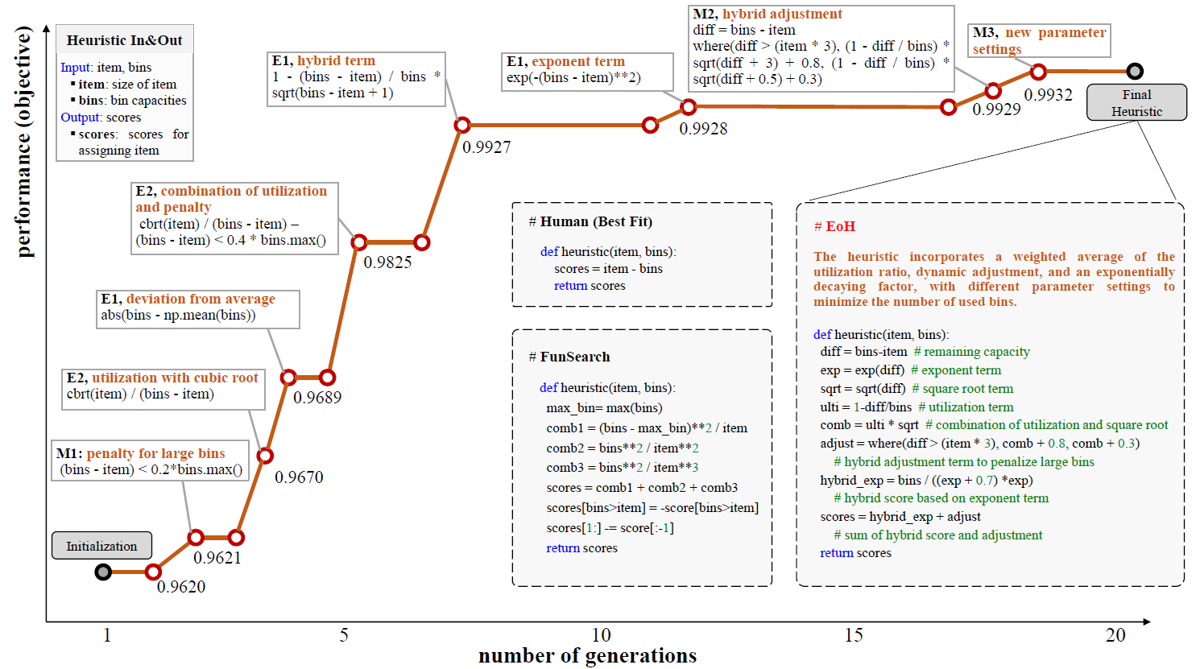
Illustration of Heuristic Evolution on Online BP

Slide 12
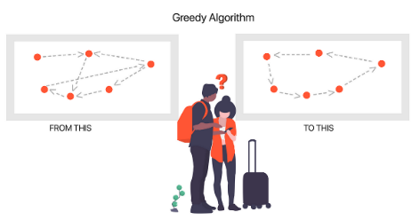
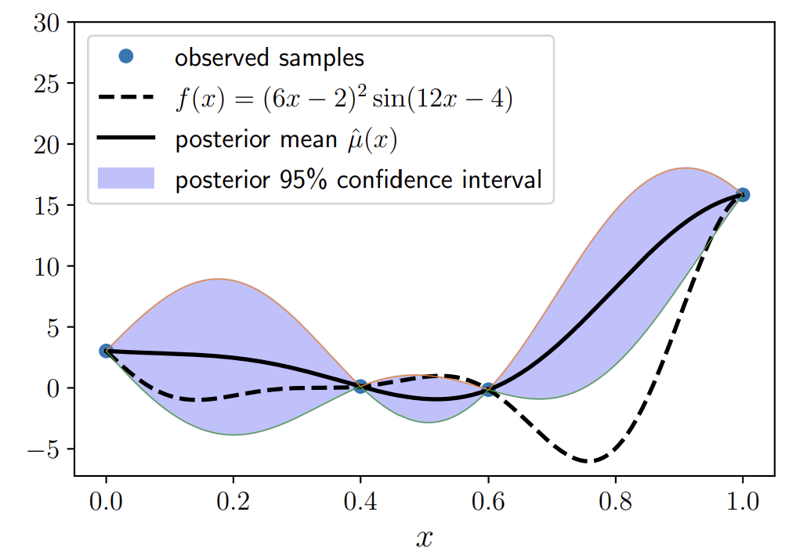
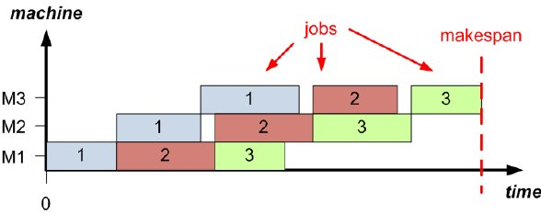
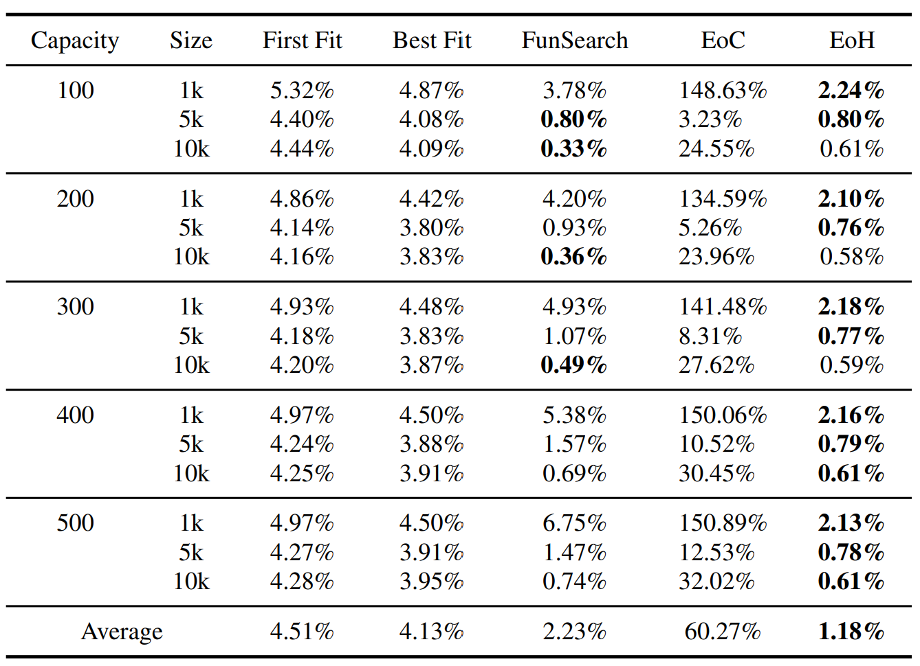
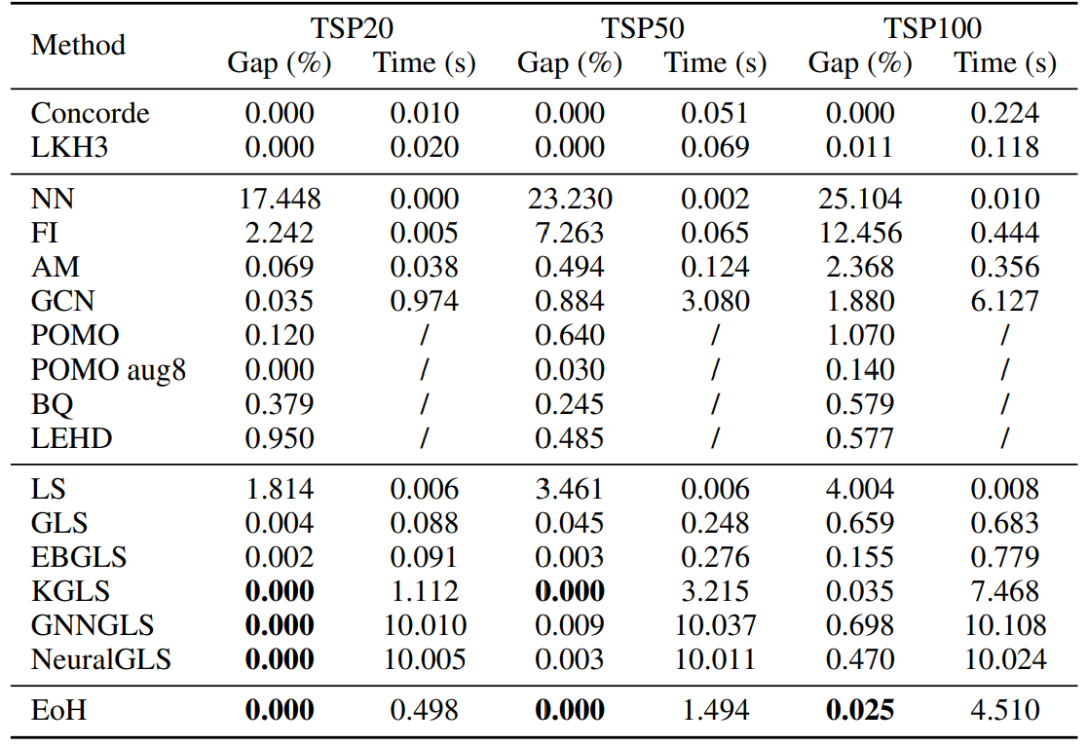
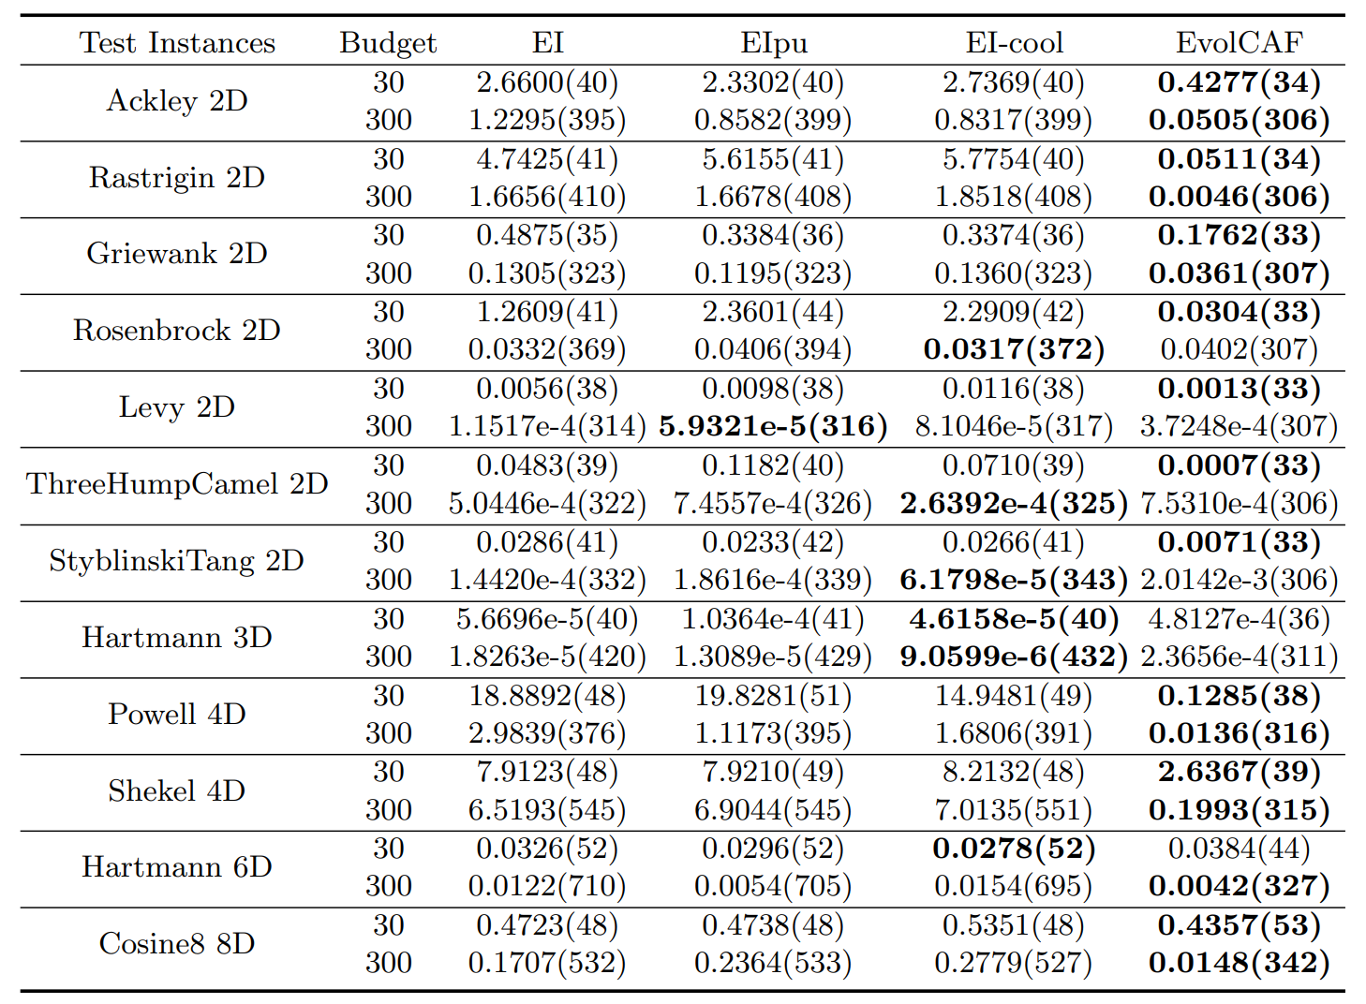
Human Competitive
Online Bin Packing Problem
Traveling Salesmen Problem
Bayesian Optimization
EoH beats Human-designed algorithm and Nature method on OBP
EoH beats 10+ Human-designed and model-based algorithms on TSP
EoH outperforms Human-designed cost-aware Bayesian optimization algorithms

Slide 13





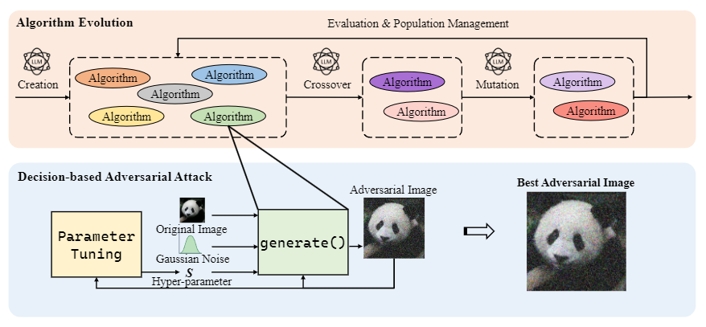
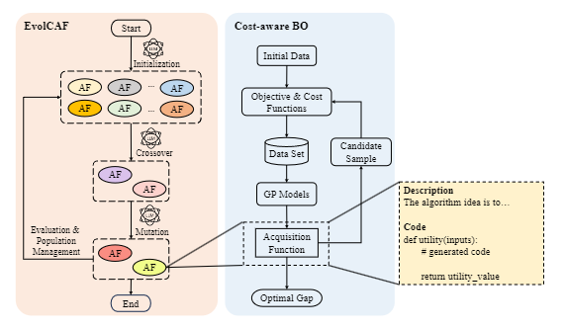
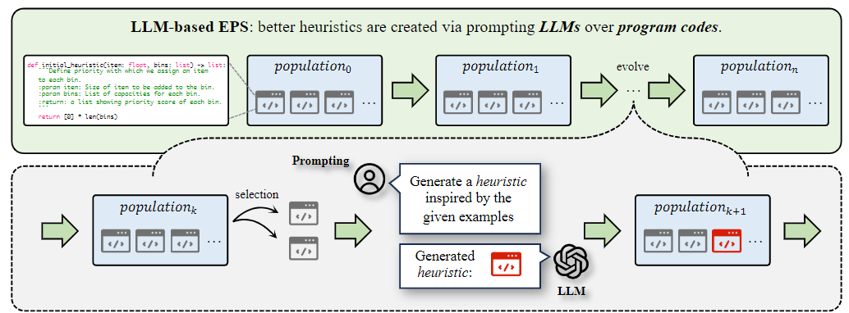
Why this Entry is the “Best”
1) Academic Recognition
EoH Accepted as
Oral (top 1.5%) ICML 2024
Application on Image Attack
Accepted at GECCO 2024
Application on Bayesian Opt. Accepted at PPSN 2024
Benchmark study
Accepted at PPSN 2024

Slide 14
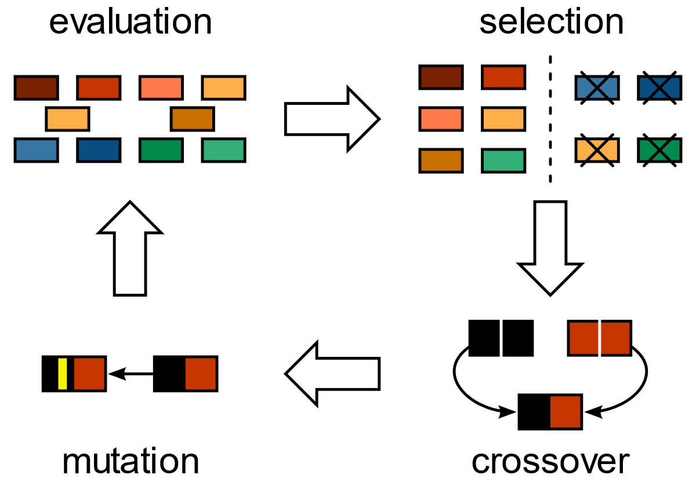
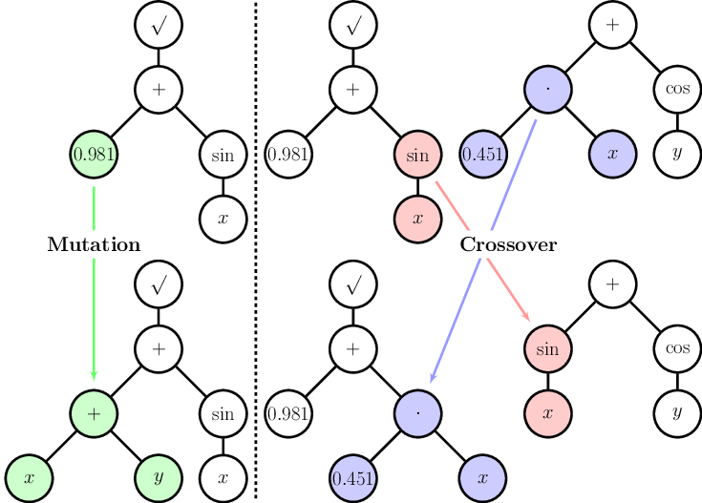
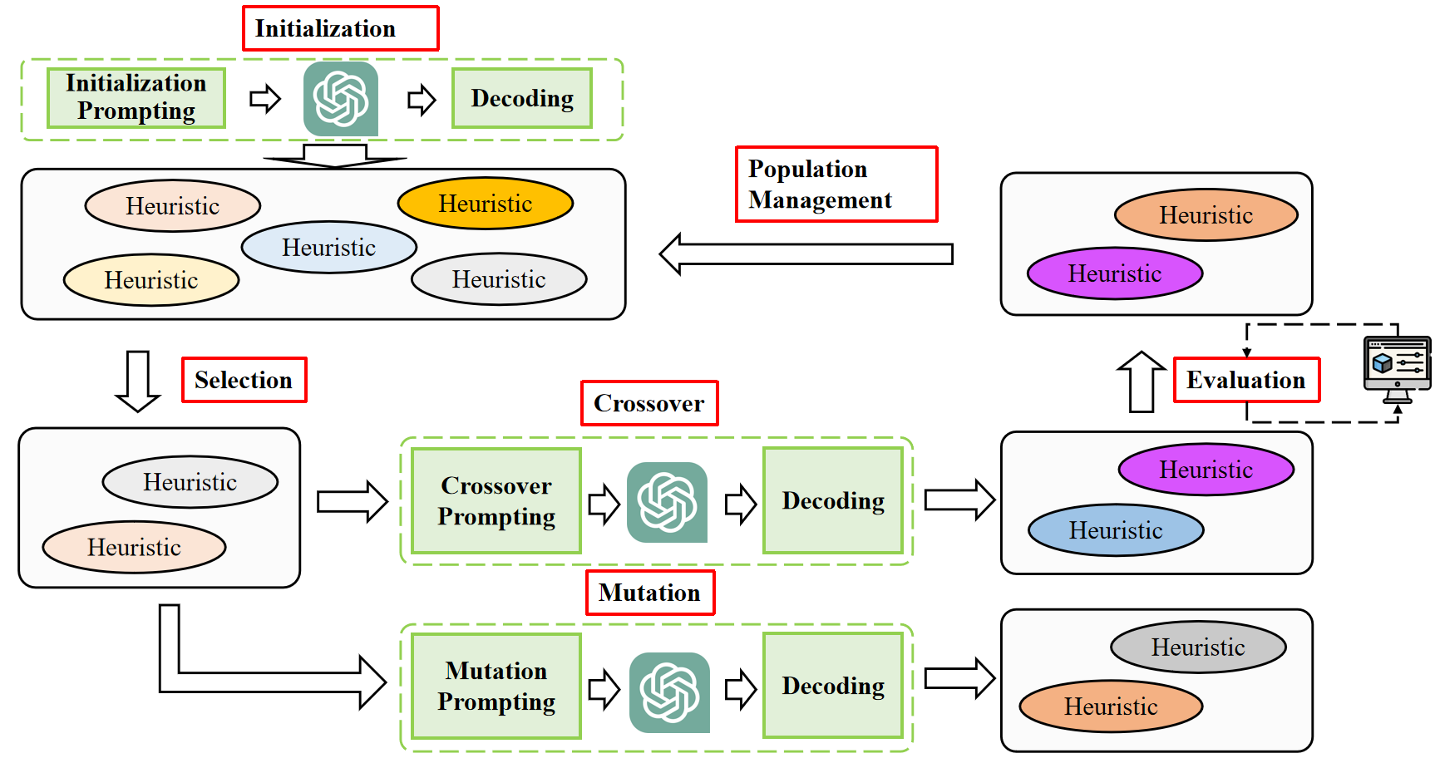
Why this Entry is the “Best”
2) Broad Impact to EC: From Evolution of Solutions to Evolution of Heuristics/Thoughts/Codes
“Evolution of
Trees/Functions/Programs”
“Evolution of
Heuristics/Thoughts/Codes”
“Evolution of Solutions”
Common Genetic Algorithm
Genetic Programming
EoH (EC+LLM)
(can be regarded as GP powered by LLM)

Slide 15
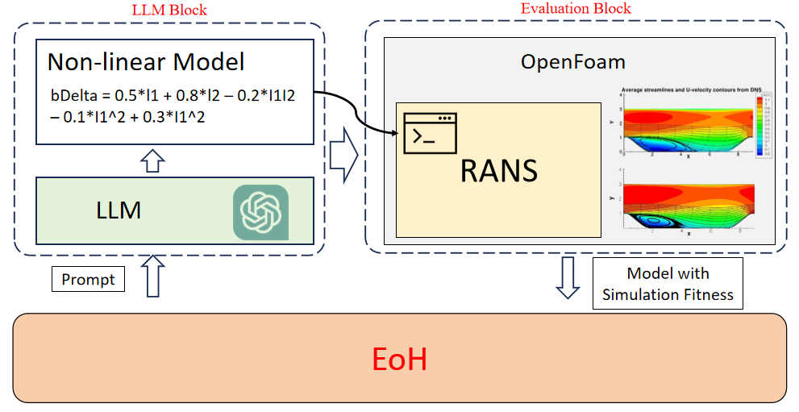
Why this Entry is the “Best”
3) Broad Impact to EC: A Standard Approach in the Future not only for Algorithm Design
An example on automatic design of turbulence model for fluid dynamic using EoH
Science discovery
Engineering design challenges
Industry planning

Slide 16
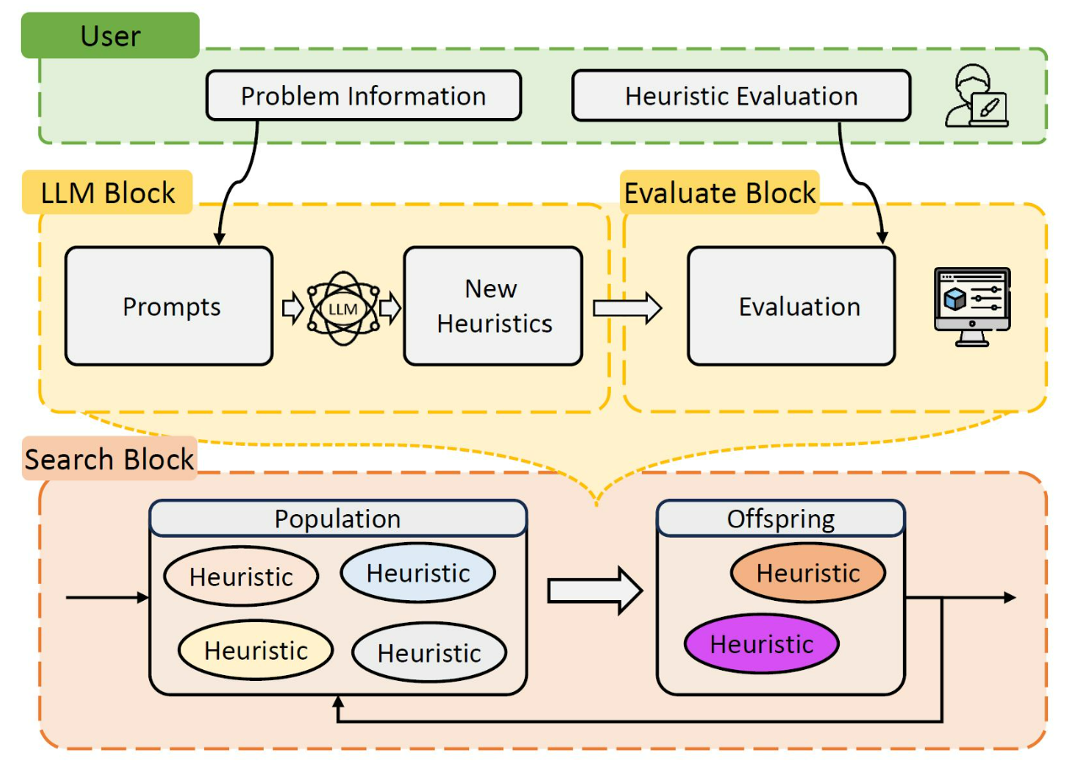
Why this Entry is the “Best”
4) Open-Source EoH Platform
EoH Platform:
https://github.com/FeiLiu36/EoH
Automatically design best-known heuristics in 30 minutes on your personal computer
Propose and test new heuristic search methods
Apply on your application scenarios

Slide 17
Conclusion
Evolution of Heuristics (EoH) combines EC and LLM as a new paradigm towards efficient automatic algorithm design
Remarks 1: EoH requires minimum human effort and no model training
Remarks 2: EoH explores new heuristics automatically leading to novel insights and outperforms human-crafted results
Remarks 3: EoH designs heuristics efficiently, in comparison to time-consuming manual crafting

Slide 18
Evolution of Heuristics (EoH)
Towards Efficient Automatic Algorithm Design using Large Language Model
Thanks!

