Slide 1



Fully Autonomous Programming with Large Language Models
Genetic Programming
Large
Language Models
Vadim Liventsev, Anastasiia Grishina, Aki Härmä, Leon Moonen
HUMIES 2023
Notes:
TODO:
UiO and Philips

Slide 2





Why autonomous programming?
task description
(specification)
fully autonomous programming tool
functional code
Enabling effect for more people to develop software and build products
Focus on creativity rather than menial technical work
Rapid prototyping and exploratory development

Slide 3





Proposed framework
Synthesize, Execute, Instruct, Debug, and Rank
task description
SEIDR
filtered out programs
bug summary
Instruct
generative LLM
Instruct
Rank
Rank
Synthesize
and Debug
Execute
generated programs
test
results
Notes:
Add beam search / search alg for RANK and automated prompt engineering/synthesis/creation/generation for INSTRUCT

Slide 4
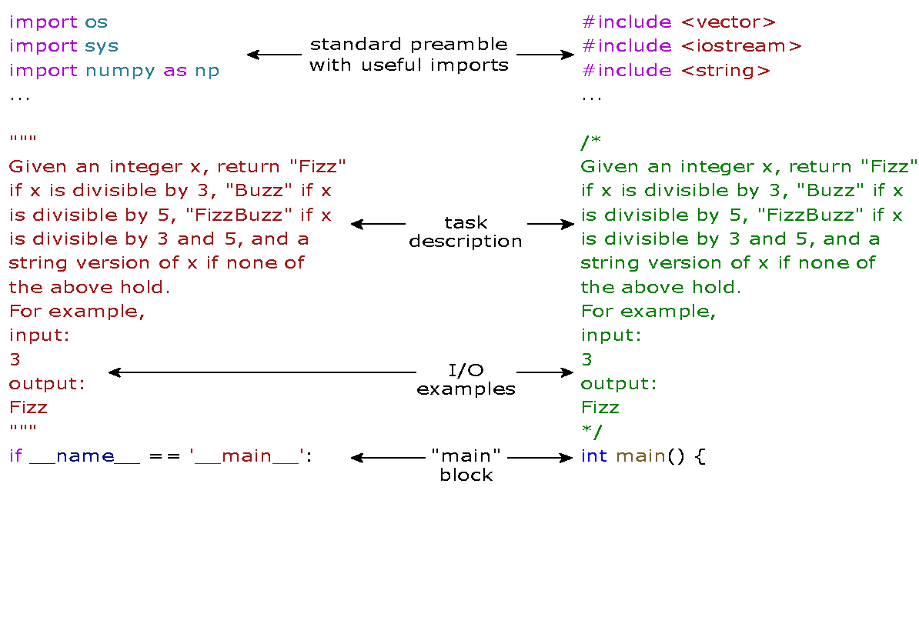
Human-like autonomous programming setup
task description
small subset of tests
template

Slide 5




Human-like autonomous programming setup
task description
small subset of tests
template
program 1
test
commit
summarize bugs
Instruct

Slide 6
Human-like autonomous programming setup
task description
small subset of tests
template
program 1
test
commit
summarize bugs

Slide 7

Human-like programming development setup
task description
small subset of tests
template
program 1
For each program in this generation:
generate 3 programs
program 2
program 3
program 4
test
git commit rolling best
Rank
keep top 2 programs
p5
p6
p7
p8
p9
summarize bugs in top 2
repeat
test
commit
summarize bugs

Slide 8
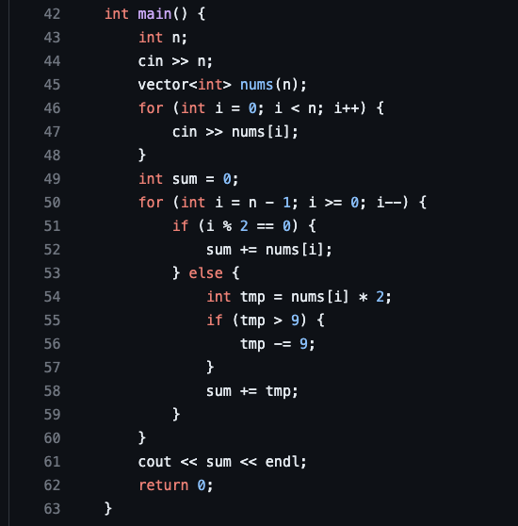
Program evolution example
Problem: Luhn, C++
Task description
Given a vector of 16 digits, <...> double every other digit starting with the second digit.
If any of the results are over 9, subtract 9 from them. Return the sum of all of the new digits.
Text completion prompt M6
The code should solve the following problem: {task}.
The code must return ['80'] for input ['16', '0 1 2 3 4 5 6 7 8 9 8 7 6 5 4 3'] but it returns 73.
Obviously, the error is that ...
Model-based bug summary M6
Resulting debug prompt (instruction):
Fix
the code is not doubling every other digit starting with the second digit.
Notes:
TODO: one slide before - full automation with pushing to git and keeping code evolution history

Slide 9
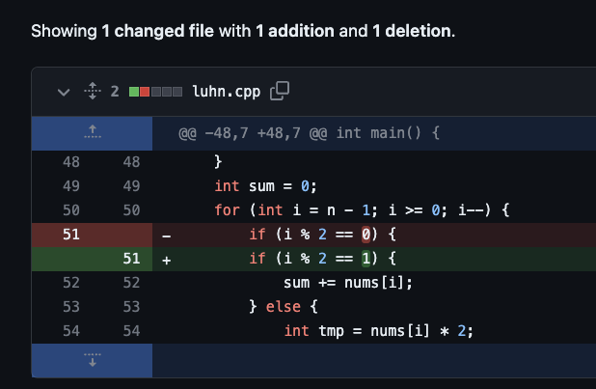
Program evolution example
Problem: Luhn, C++
Task description
Given a vector of 16 digits, <...> double every other digit starting with the second digit.
If any of the results are over 9, subtract 9 from them. Return the sum of all of the new digits.

Slide 10
Why is SEIDR human-competitive?
SEIDR is a fully autonomous programming framework that starts with task specifications
and debugs solutions until the specifications are met.
SEIDR performs better or on par with PushGP⁴ on the PSB2 competitive programming benchmark.
The contribution is twofold:
flexibility to switch between repair-only, replace-only and hybrid debug strategies;
rubber duck debugging with two language models as agents for bug explanation and repair;
SEIDR is a solution to the tedious last mile problem of debugging programs
which are superficially similar to correct programs.
⁴ T. Helmuth and P. Kelly, “Applying genetic programming to PSB2: the next generation program synthesis benchmark suite,” Genetic Programming and Evolvable Machines, vol. 23, no. 3, pp. 375–404, Sep. 2022, doi: 10/gq5gjq.
Notes:
(not line-by-line, but summarizing the bug)

Slide 11
Why SEIDR?
Main messages for the field
Intersection of genetic algorithms and large language models is an exciting research area
SEIDR is built to enable “plugging in” other language models
for code generation and text completion to experiment more
Consider pushing candidate solutions to git: it is useful to track and analyze the evolution history
SEIDR is a step towards explainable AI pipelines in autonomous programming
Paper: Vadim Liventsev, Anastasiia Grishina, Aki Härmä, Leon Moonen,
Fully Autonomous Programming with Large Language Models, GECCO 2023
HUMIES 2023

