Slide 1




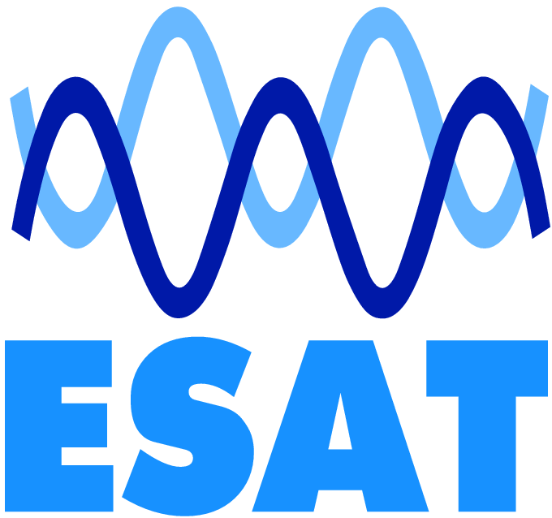


Designing Hardware-Friendly Hash Functions for Network Security Using Cartesian Genetic Programming
Mujtaba Hassan, Jo Vliegen, Stjepan Picek, Nele Mentens

Slide 2
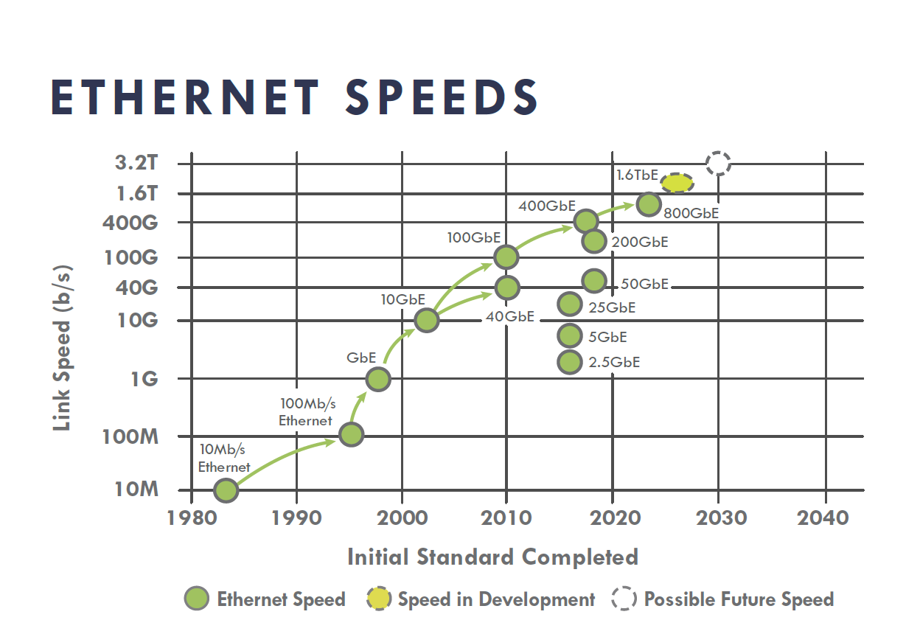


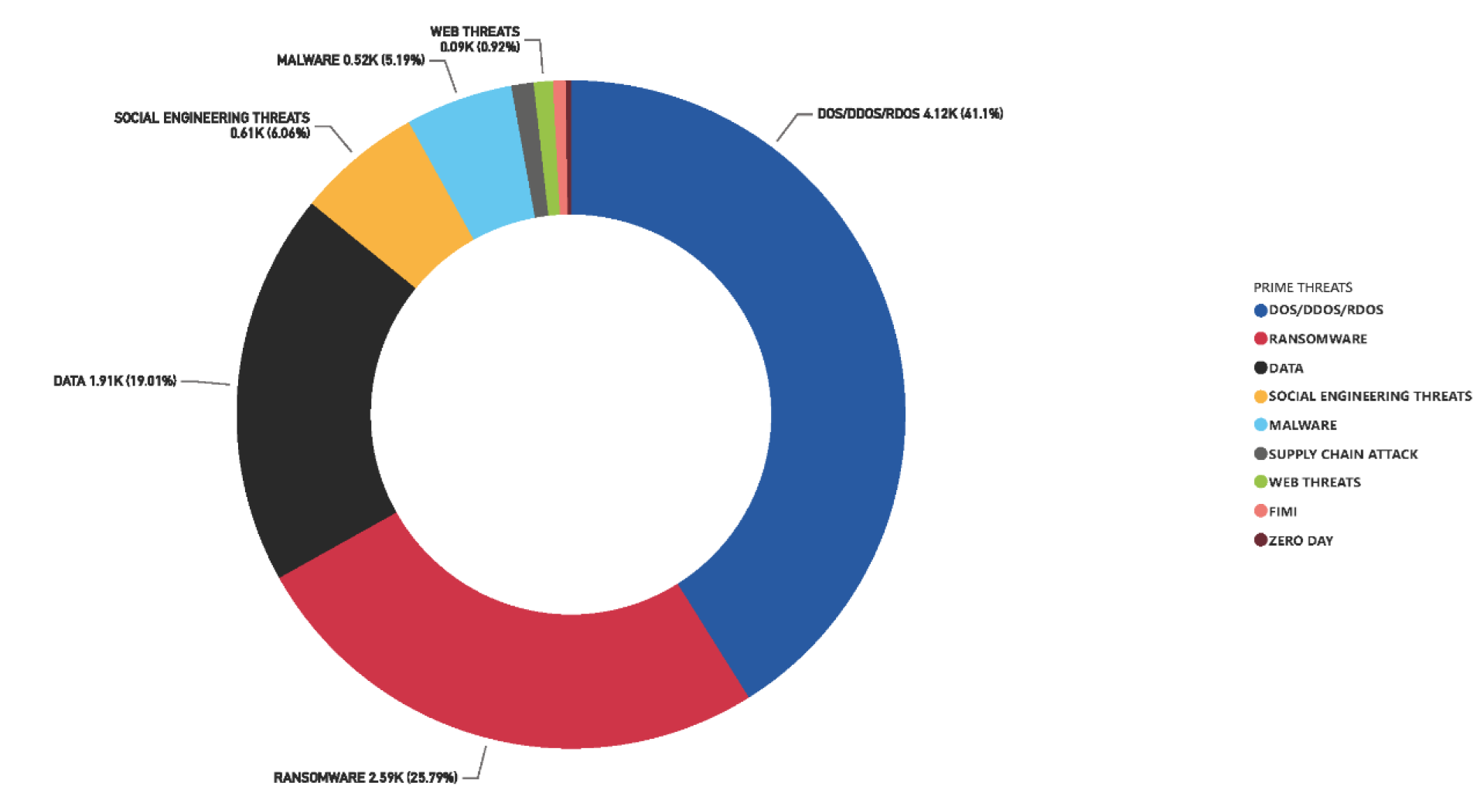
Growing Network Security Challenges
Traffic Volume Surge
High-Speed Networks
Network bandwidth demands are increasing exponentially
Terabit Ethernet networks are becoming a standard
Cyber Attack Proliferation
More sophisticated DDoS and other cyber threats are emerging
5.6 Tbps attack

Slide 3

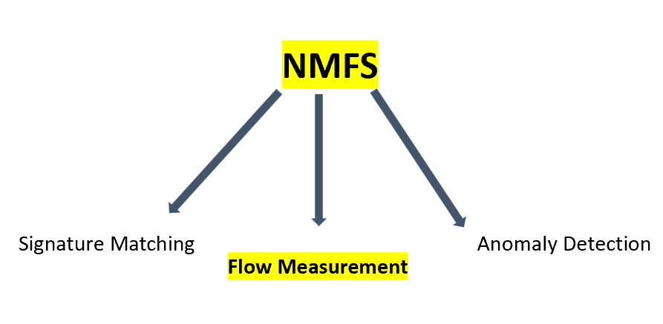
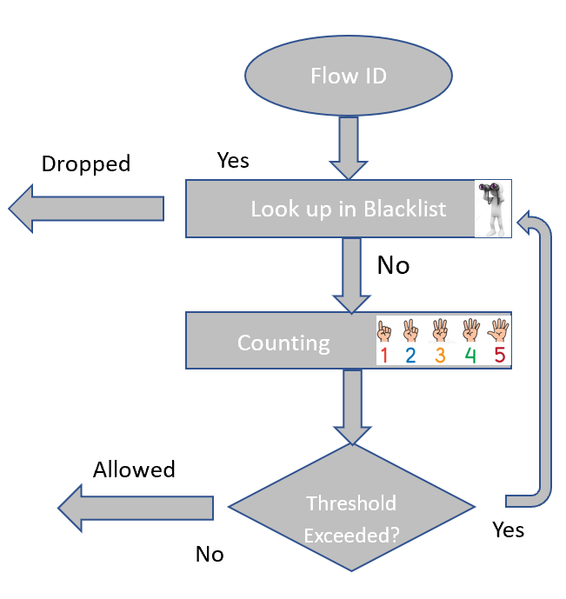
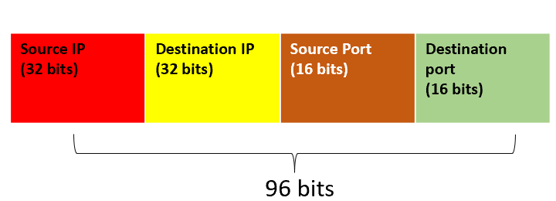
Network Monitoring and Filtering Systems (NMFS)

Slide 4


Network Monitoring and Filtering Systems (NMFS)

Slide 5


Probabilistic vs Exact Data Structures for Lookups
Exact Data Structures
Probabilistic Data Structures
Use Cases
Accurate but less scalable, e.g., arrays, lists
Prefer probabilistic structures when
  Speed and memory have priority
  Dealing with high volume of data
  A few false positives are tolerable
Fast, space-efficient, and scalable, with some false positives, e.g., Bloom filters
Source: Photos created using Google Gemini

Slide 6
Probabilistic vs Exact Data Structures for Lookups
  Non-Cryptographic hash functions are core components of probabilistic structures
Exact Data Structures
Probabilistic Data Structures
Use Cases
Accurate but less scalable, e.g., arrays, lists
Prefer probabilistic structures when
  Speed and memory have priority
  Dealing with high volume of data
  A few false positives are tolerable
Fast, space-efficient, and scalable, with some false positives , e.g., Bloom filters
Source: Photos created using Google Gemini

Slide 7
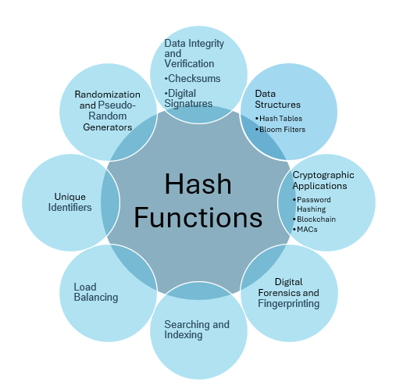
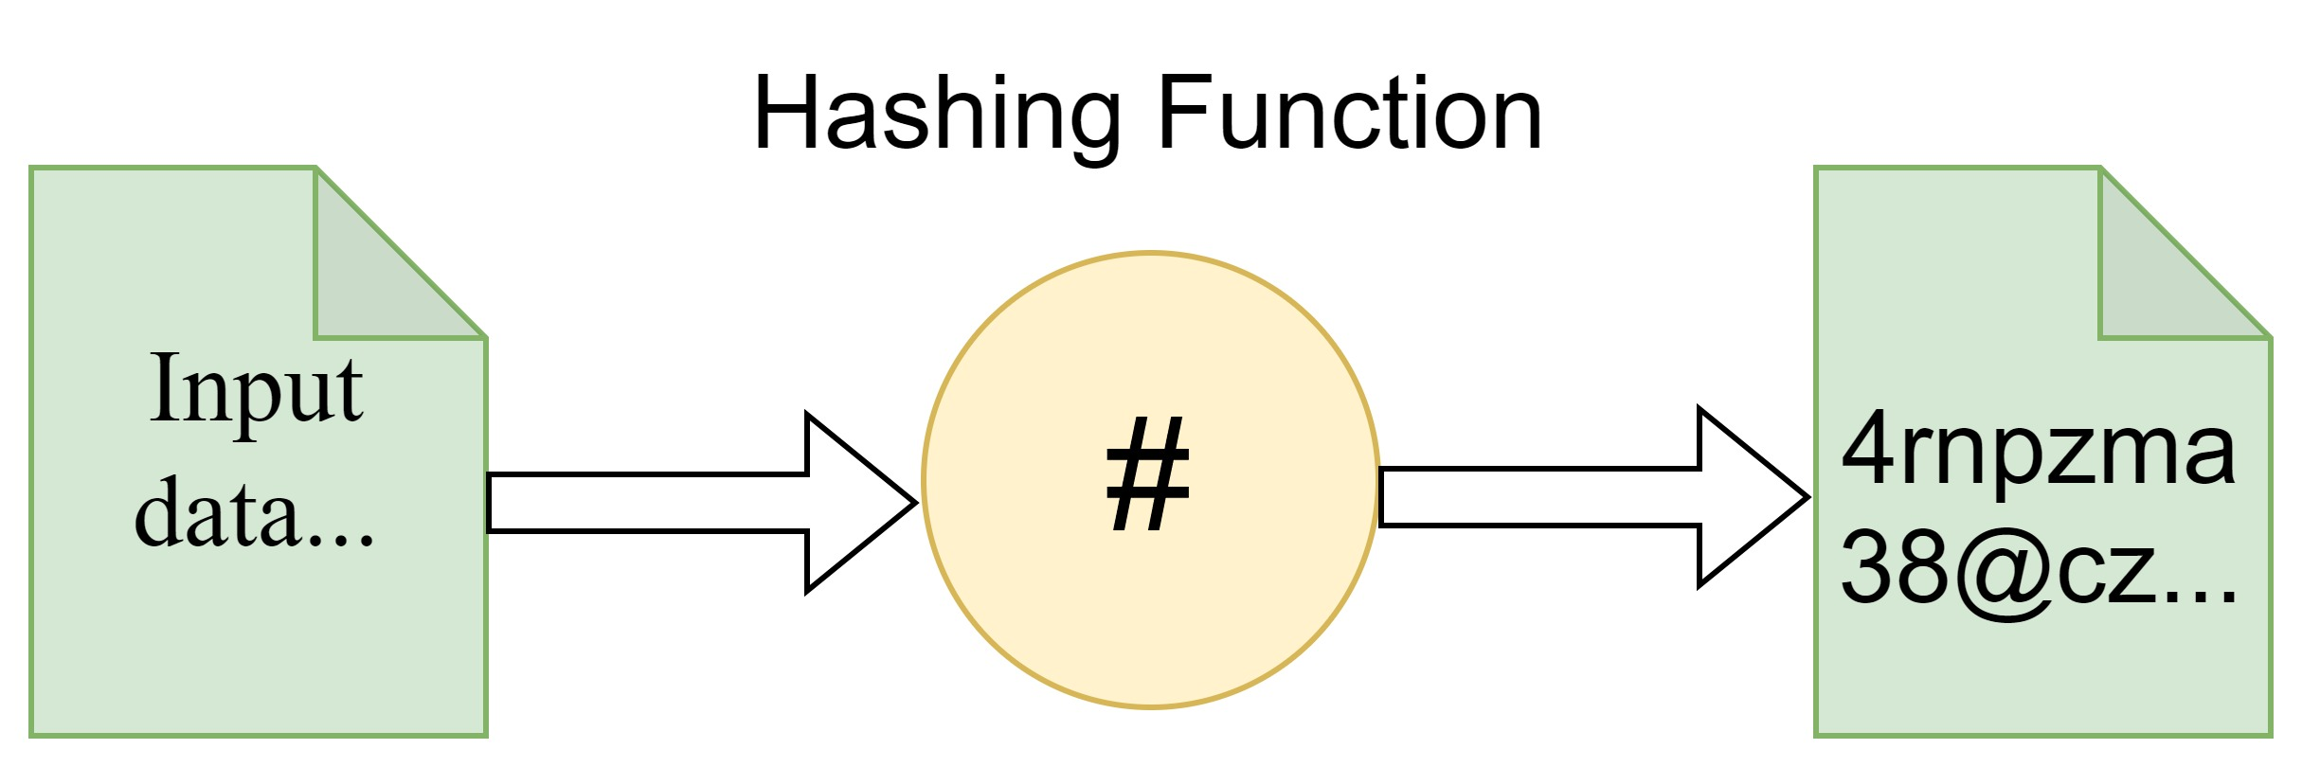
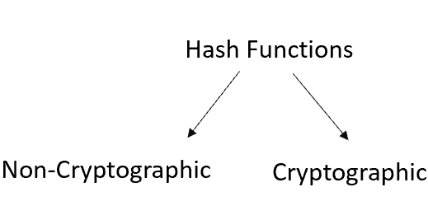
Hash Functions
Designing a hash function is extremely difficult due to the nonlinear and complex behavior between input and output
Hardware-oriented hash functions pose additional challenges not faced in software-oriented designs
Their performance is typically assessed in terms of latency, operating frequency, throughput, and resource utilization on FPGAs
Evolutionary Computation, such as GP and CGP, excels in such situations

Slide 8
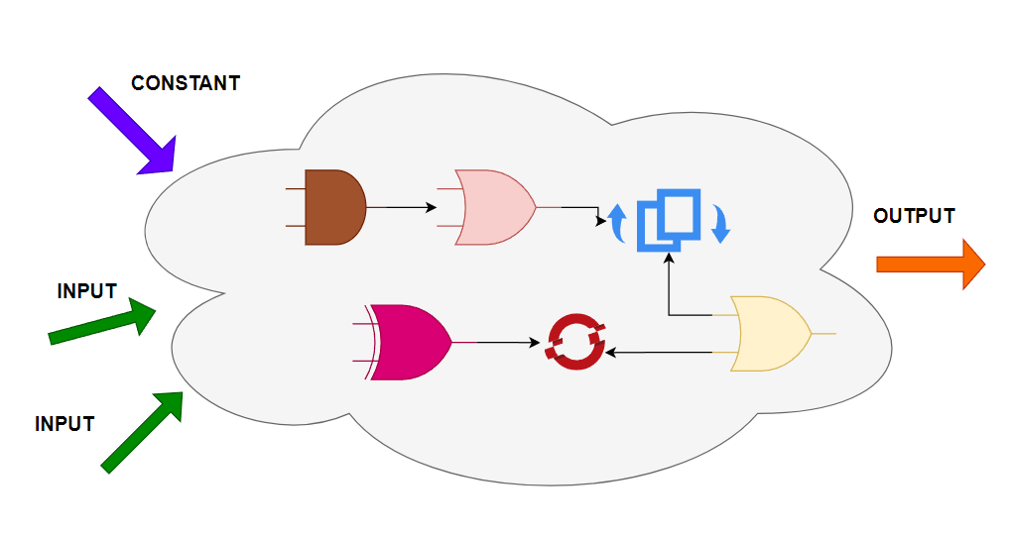
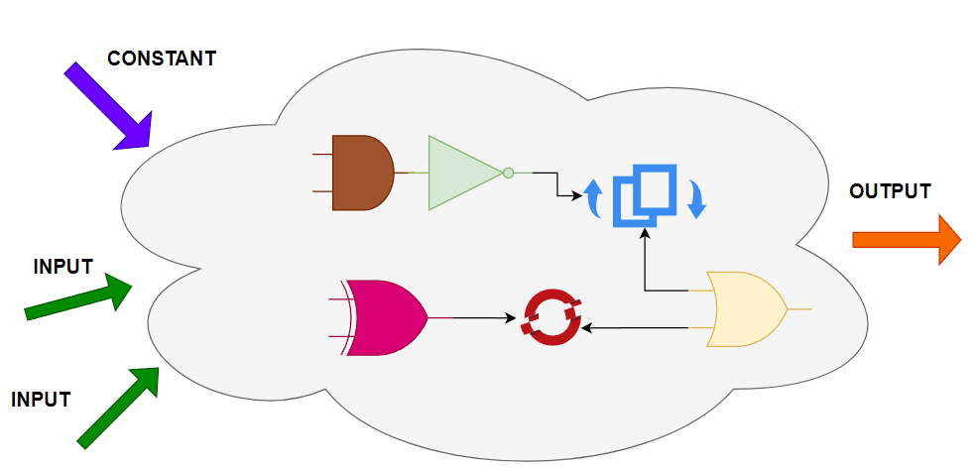
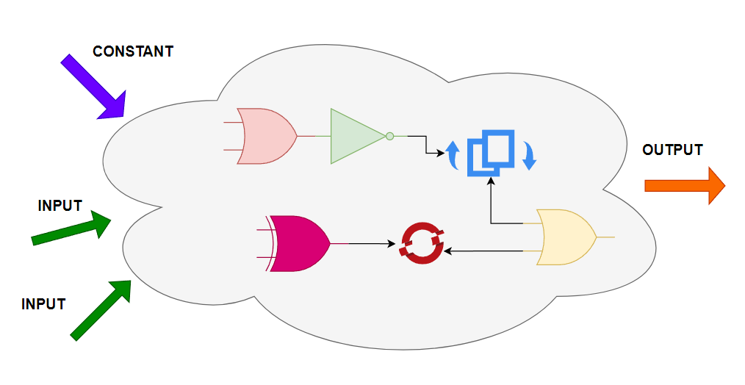
Why is it difficult for humans and machines? (one scenario)
7⁵⁰⁰ combinations —
a number with over 422 digits
Even a supercomputer (Frontier) will take
more time than the age of the universe to try all possible combinations

Slide 9
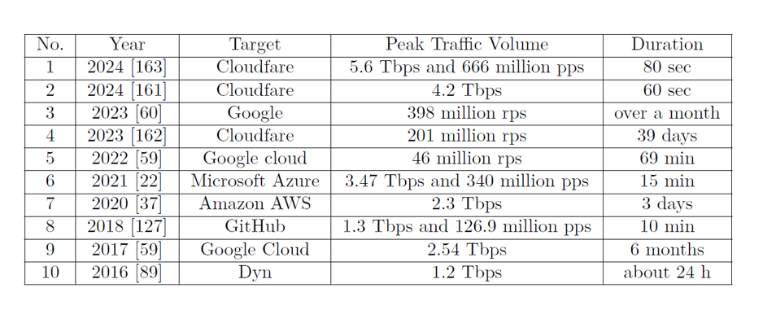
Why are HW-friendly hash functions critical?
5.6 Tbps = 700 GB/s throughput
With a minimum packet size of 64 bytes,
it is necessary to process 10 billion packets
per second
Major DDoS attacks

Slide 10
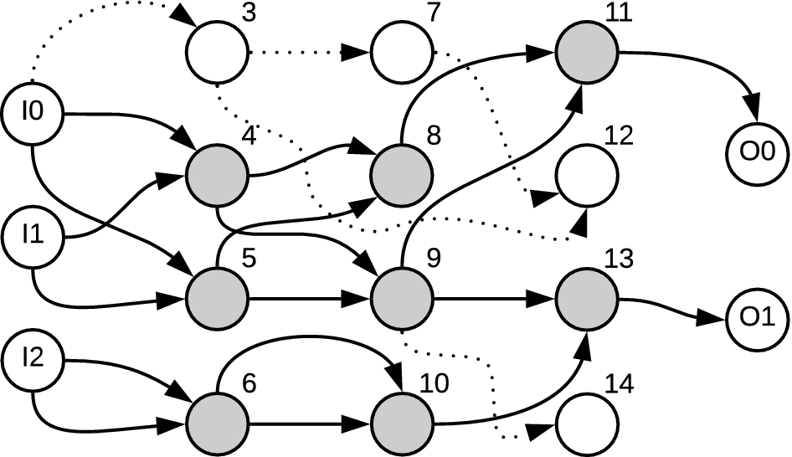
Cartesian Genetic Programming (CGP)
The solution to a given problem is represented as a 2D
grid of nodes
CGP allows node re-usage and possesses neutral genetic
drift (NGD)

Slide 11
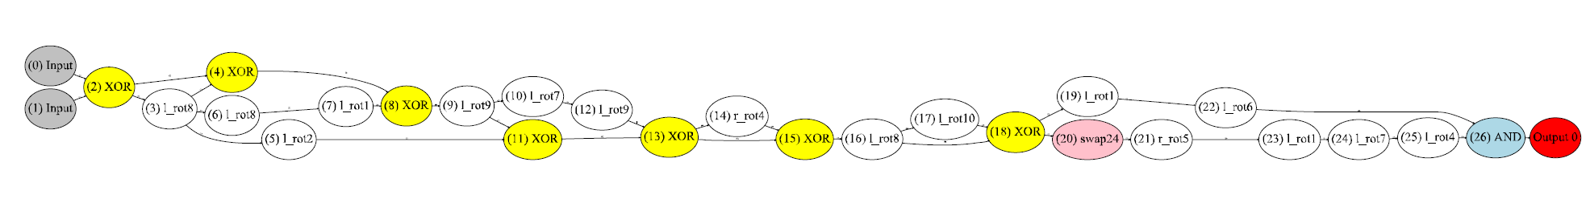
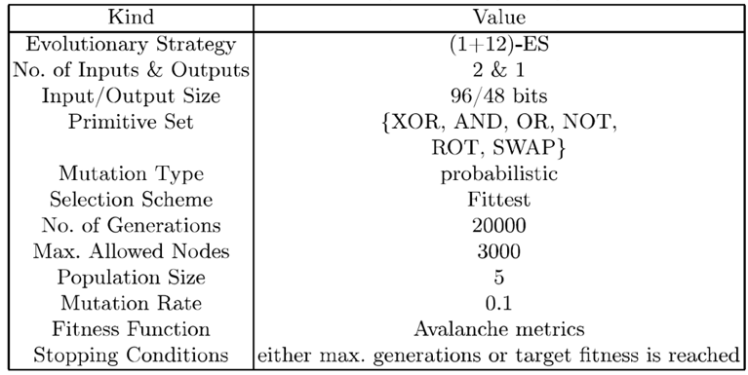
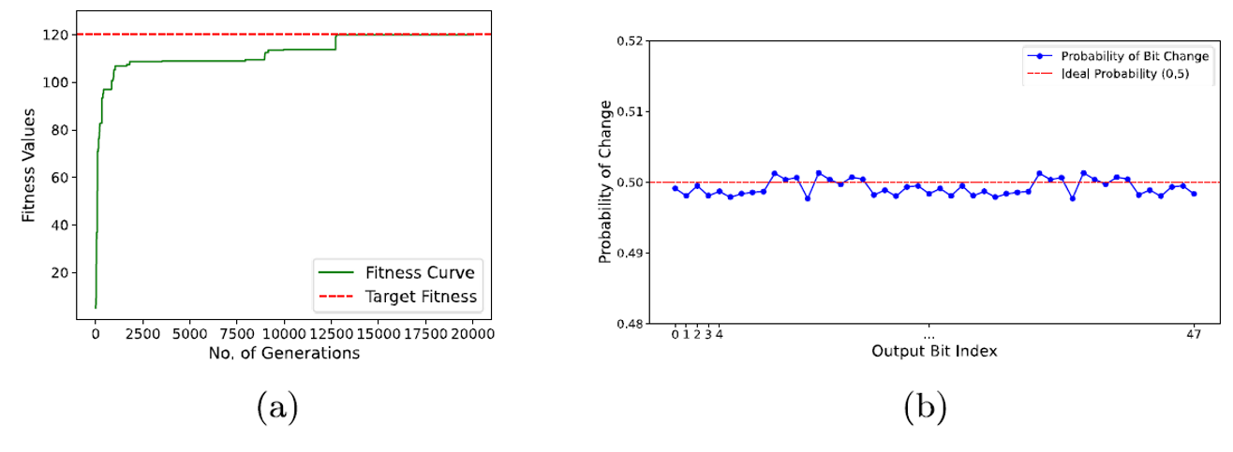
Final Design

Slide 12
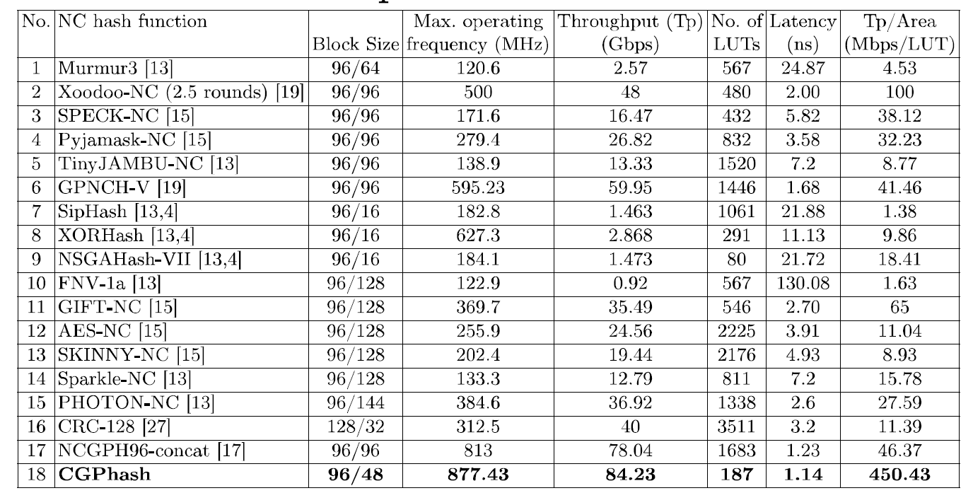
FPGA Performance Comparison with Related Work
7.92% improvement in operating frequency and throughput, along with a 7.3% improvement in latency
Hand Crafted
Hand Crafted
Throughput per Area (Tp/Area) improved by 4.5 times
Hand Crafted
Ours

Slide 13
Impact
Amazon AWS
Google Cloud
Microsoft Azure
Cloud and infrastructure providers
Observability and monitoring platforms
DDoS mitigation companies
Datadog
New Relic
Dynatrace
Splunk
NinjaOne
Cloudfare
Akamai
Radware
Fortinet
Arbor Networks
Ericsson
Huawei
Nokia
Lockheed Martin
BAE systems
Raytheon
Rafale
Telecom and ISP
infrastructure vendors
Defense contractors

Slide 14
Why we are the best
No training on the dataset is required
Best resource utilization
Best computational speed
Outperforms all state-of-the-art
Non-Cryptographic hash functions
Notes:
7

Slide 15
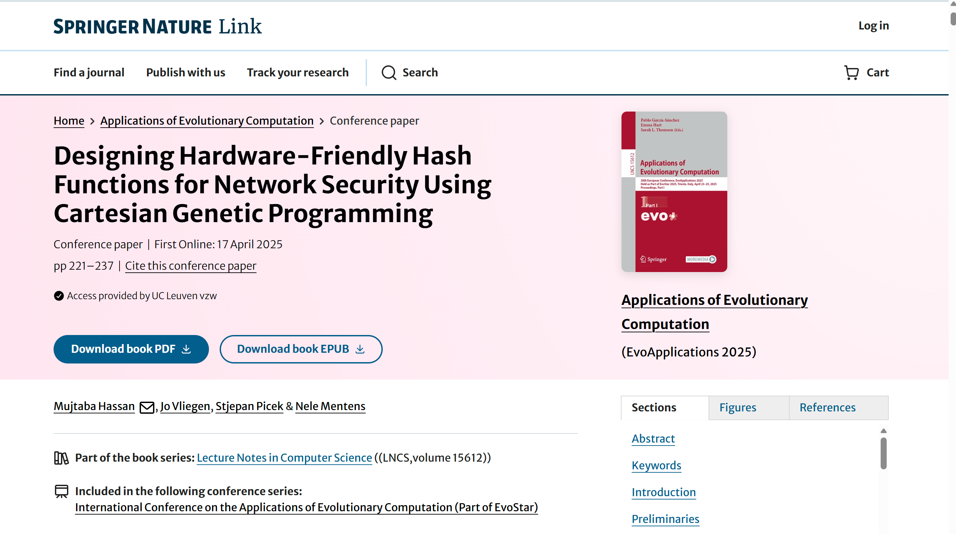

Paper

Slide 16
THANK YOU!

