Slide 1
Evolutionary design of explainable algorithms for biomedical image segmentation
Kévin Cortacero, Brienne McKenzie, Dennis G. Wilson, Hervé Luga, Salvatore Valitutti, Sylvain Cussat-Blanc

Slide 2
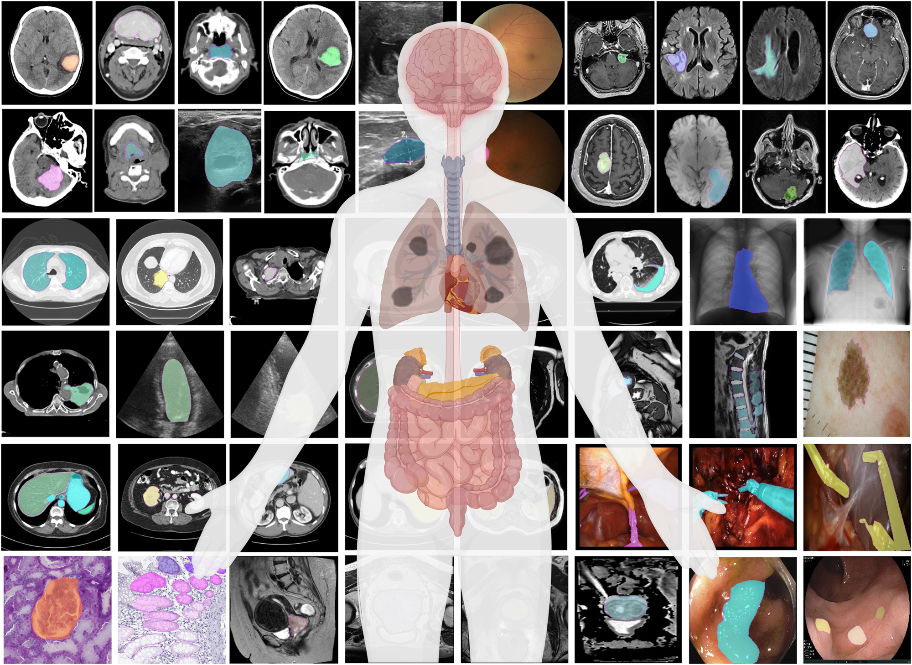
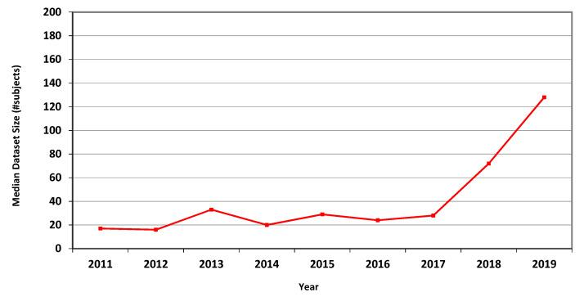
Biomedical image analysis is booming
Strong societal and industrial impact and demand
More and more acquisition techniques
Hospital and biological labs have large image datasets
Hard to analyze because of their complexity and diversity
But it is difficult to analyze these images
Manual → can lead to subjective decisions
Automated → requires high computer vision expertise
Various needs: classification, detection, segmentation
https://www.nature.com/articles/s41467-024-44824-z/figures/1
Median dataset size by number of subjects over time
https://www.ncbi.nlm.nih.gov/pmc/articles/PMC8404917/

Slide 3
Deep learning has revolutionized image analysis
Deep learning is widely used to analyze medical images, but…
needs huge datasets to be trained
  it learns filters from scratch
doesn’t reliably capture rare events
  cell divisions, rare cell shapes
is a blackbox approach
  only post-hoc explainability
We have decades of experiences in developing image analysis algorithms
Human-designed image pipelines outpaced by machine learning methods for specific data-driven applications
Proposition: What if we could
build these pipelines automatically?

Slide 4
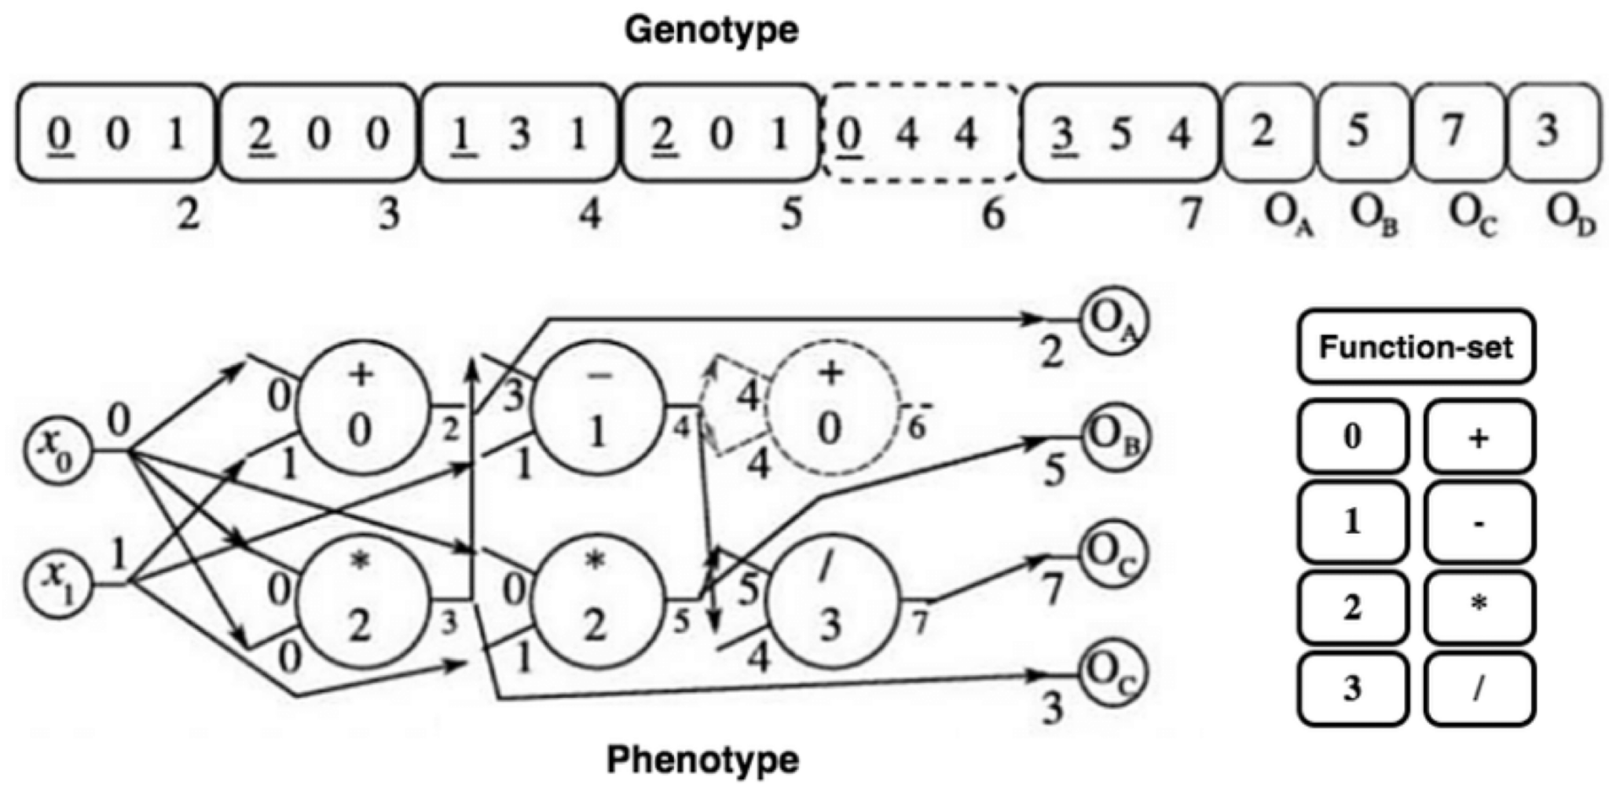
Cartesian Genetic Programming
Indirect encoding of functional graph into a sequence of integers
Miller, Julian Francis, and Simon L. Harding. "Cartesian genetic programming." In Proceedings of the 11th annual conference companion on genetic and evolutionary computation conference: late breaking papers, pp. 3489-3512. 2009. Image taken from: Miragaia, Rolando, Francisco Fernández, Gustavo Reis, and Tiago Inácio. "Evolving a multi-classifier system for multi-pitch estimation of piano music and beyond: an application of Cartesian genetic programming." Applied Sciences 11, no. 7 (2021): 2902.

Slide 5
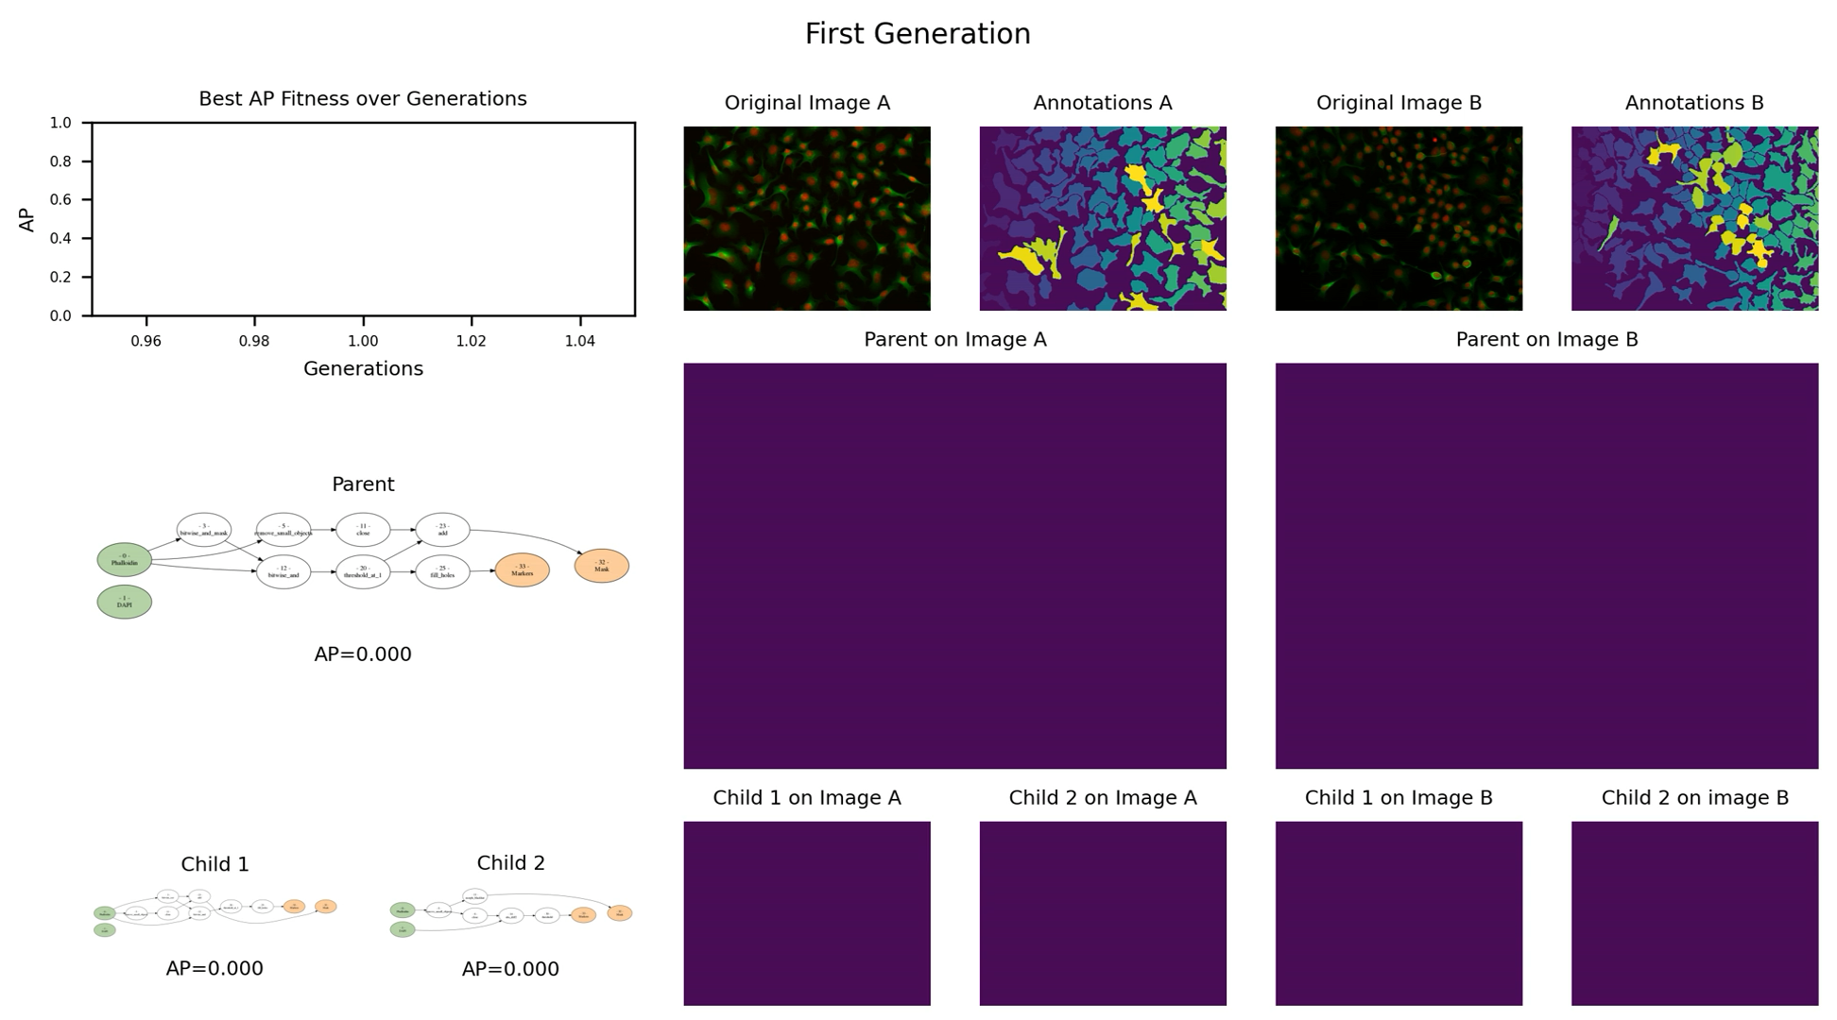
CGP for Biomedical Image Analysis
Cortacero, Kévin, et al. "Evolutionary design of explainable algorithms for biomedical image segmentation." Nature communications 14.1 (2023): 7112.

Slide 6
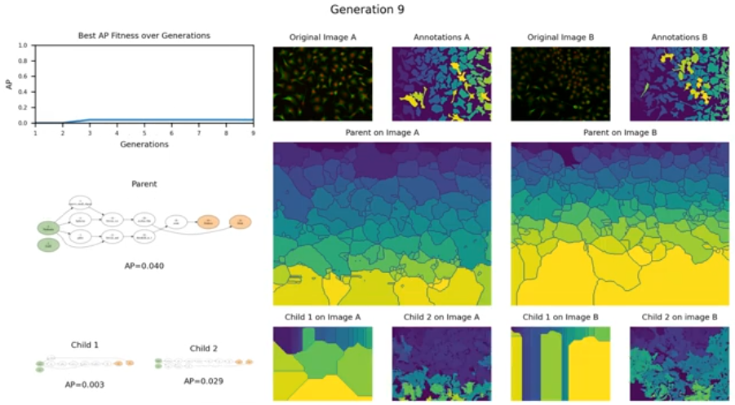
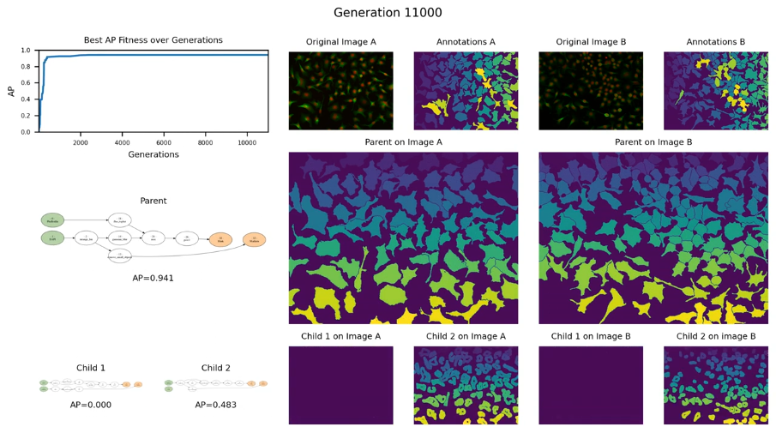
CGP for Biomedical Image Analysis
Cortacero, Kévin, et al. "Evolutionary design of explainable algorithms for biomedical image segmentation." Nature communications 14.1 (2023): 7112.

Slide 7
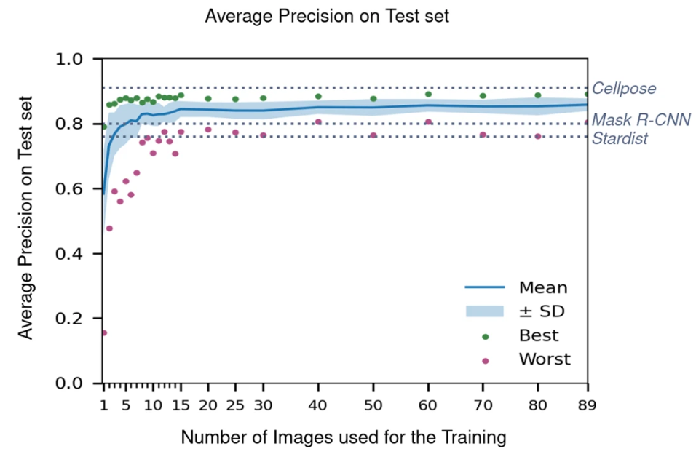
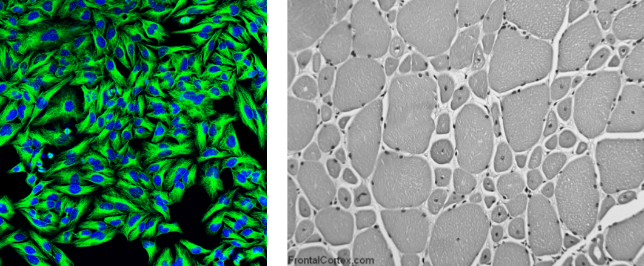
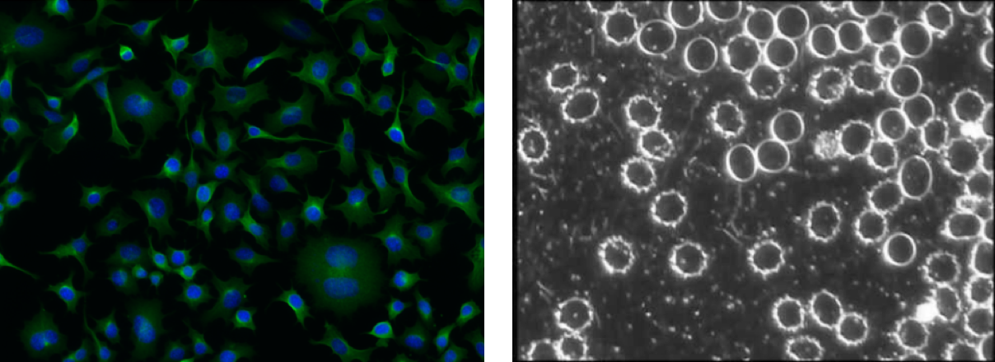
CGP needs fewer labelled images
(B) The result is equal to or better than a result that was accepted as a new scientific result at the time when it was published in a peer-reviewed scientific journal.
Dataset: Cellpose (100 images of cells)
Deep learning models (Cellpose, Mask RCNN, Stardist):
  Train on 70,000 images
  Fine-tune on 89 Cellpose images
CGP evolves models from scratch on a subset of Cellpose
Cortacero, Kévin, et al. "Evolutionary design of explainable algorithms for biomedical image segmentation." Nature communications 14.1 (2023): 7112.

Slide 8
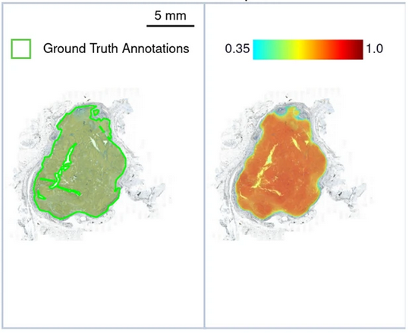
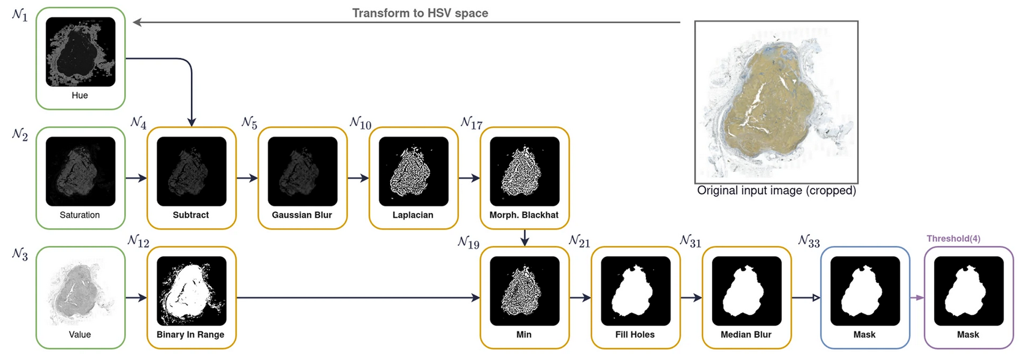
CGP generates usable and interpretable pipelines
Best evolved pipeline and explanation on melanoma nodule detection
The pipeline starts by subtracting the Hue channel from the Saturation channel to exclude CD8+ T cells and other tumor microenvironment cells. A Gaussian Blur is applied to smooth the area, followed by a Laplacian filter to detect tumor borders. A Morphological Black Hat is used to highlight segmented areas, accurately estimating the tumor area. In parallel, a binary mask of the Value channel creates a global area map. These maps are merged to refine the area of interest, followed by a Fill Hole filter to create a solid binary mask. Finally, a Median Blur filter removes edge noise, sharply delimiting tumor nodules.
Ground truth
CGP mask
Cortacero, Kévin, et al. "Evolutionary design of explainable algorithms for biomedical image segmentation." Nature communications 14.1 (2023): 7112.

Slide 9
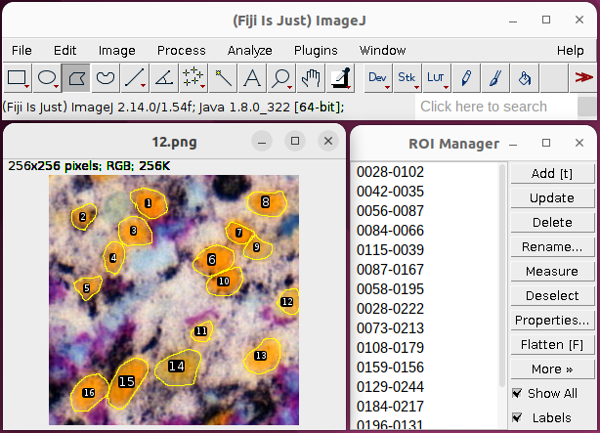
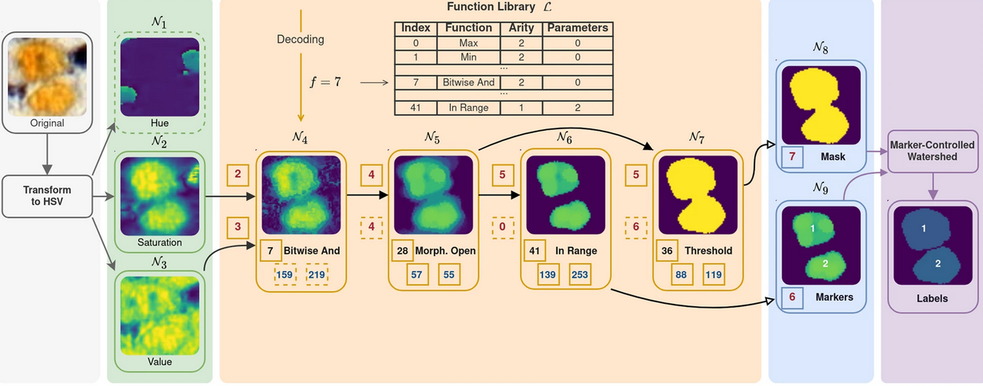
A human-competitive approach
(E) The result is equal to or better than the most recent human-created solution to a long-standing problem for which there has been a succession of increasingly better human-created solutions.
Human
CGP
Time consuming
Subjective
Fatigue
Tedious
Limited expertise
Fast
Objective
Transparent/Readable
General
Unlimited

Slide 10
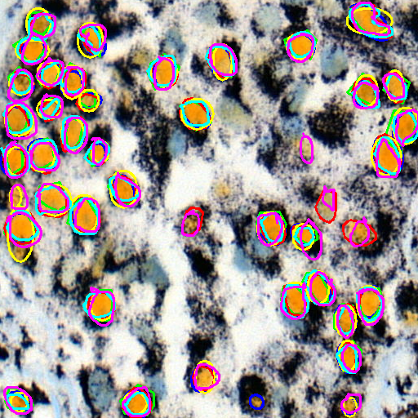
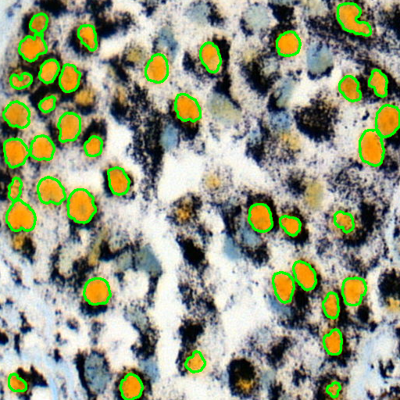
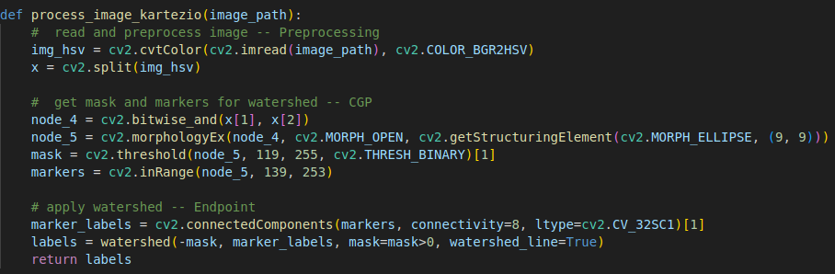
A human-competitive approach
(E) The result is equal to or better than the most recent human-created solution to a long-standing problem for which there has been a succession of increasingly better human-created solutions.
Human
CGP
5 experts
mAP = 0.81
mIoU = 0.73
mTime = 3m30
mROI = 263
1 CGP-generated model
AP = 0.80
IoU = 0.77
mTime = 0.01s (100fps)
ROI = 254
H1: 19m 43s (ellipses) = 290 ROIs
H2: 21m 30s (polygons) = 240 ROIs
H3: 30m 20s (ellipses) = 244 ROIs
H4: 32m 45s (polygons) = 234 ROIs
H5: 35m 53s (freehand) = 283 ROIs
H6: 45m 38s (polygons) = 287 ROIs
Ground Truth: 282 ROIs (9 images)

Slide 11
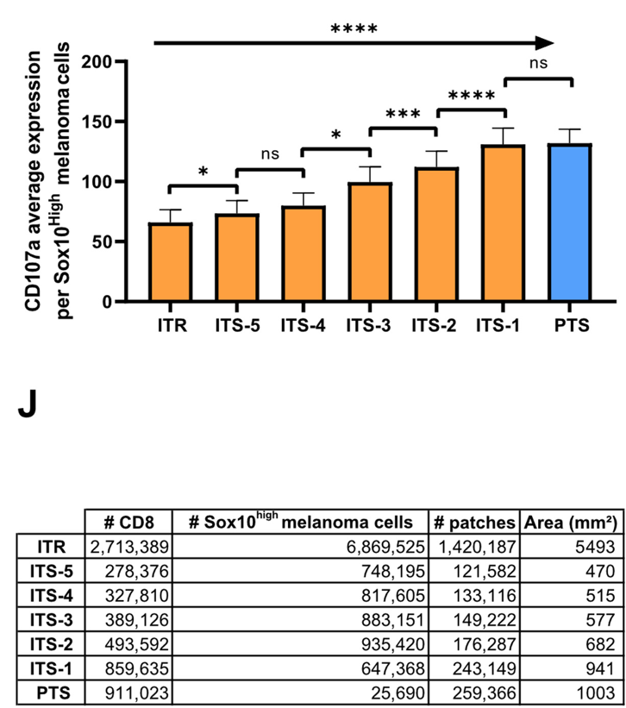
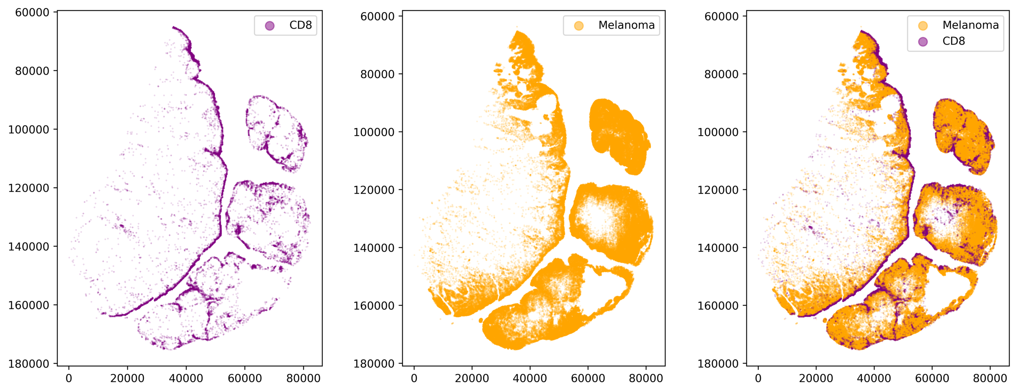
Published case study using CGP
(D) The result is publishable in its own right as a new scientific result independent of the fact that the result was mechanically created.
Millions of cells annotated by CGP in minutes
Leads to robust statistics and more accurate analysis of biological images
Filali, Liza, et al. "Ultrarapid lytic granule release from CTLs activates Ca2+-dependent synaptic resistance pathways in melanoma cells." Science Advances 8.7 (2022).

Slide 12
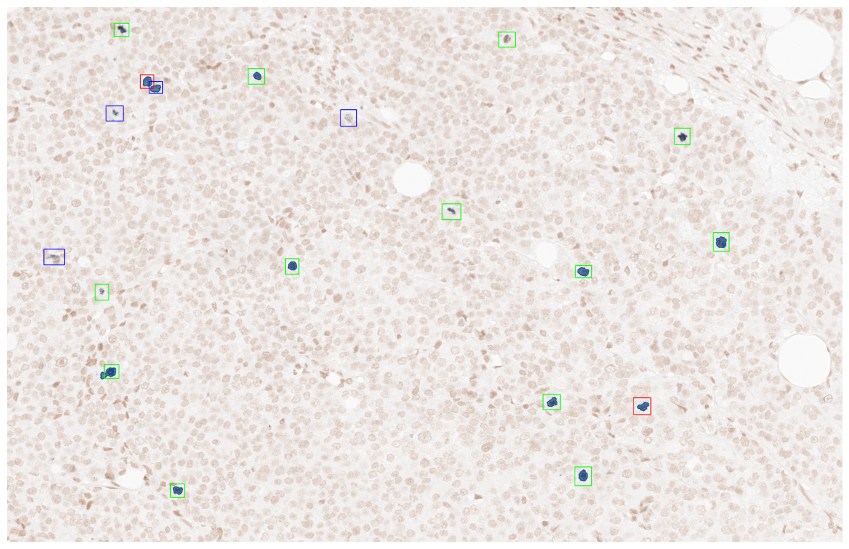
Why it is important
Case study in histopathology
Pathologists use key indicators
to evaluate the tumor aggressivity:
Number of cell divisions (rare event)
Cell organization in the tumor
Other cell metrics
But they are difficult for humans to detect in an image that contains millions of cells
=> pathologists often make decisions based on a subsection of the image.
Our approach can be instrumental to generate whole-image statistically robust and objective evaluations to improve diagnosis.
Human-annotated sub-section (~2%)​ ​of an
Immuno Histo Chemistry (IHC) image of breast cancer

Slide 13

Ongoing industrial transfer
(A) The result was patented as an invention in the past, is an improvement over a patented invention, or would qualify today as a patentable new invention.
A patent application has been filed by KC, SV, SCB, DW, HL, and BM.: “K. Cortacero et al. filed patent; EP 22307041.8”
Kartezio remains the academic project: kartezio.com
A new startup based on advanced CGP models for image processing for real-world applications is currently being created.

Slide 14
