Slide 1



Towards Evolving Malware Variants as Antigens for Antivirus Systems
20th Annual Humies Awards, Lisbon, Portugal
Ritwik Murali and C Shunmuga Velayutham
Amrita Vishwa Vidyapeetham University,
Tamil Nadu, India
a: Evolving malware variants as antigens for antivirus systems, Expert Systems with Applications, 2023
b: Adapting novelty towards generating antigens for antivirus systems, GECCO, 2022

Slide 2
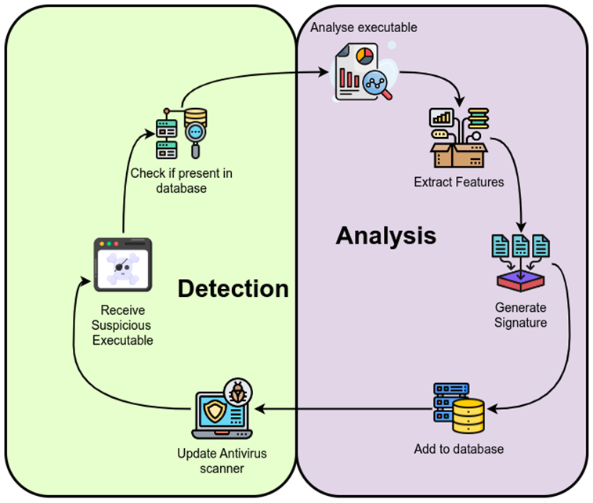
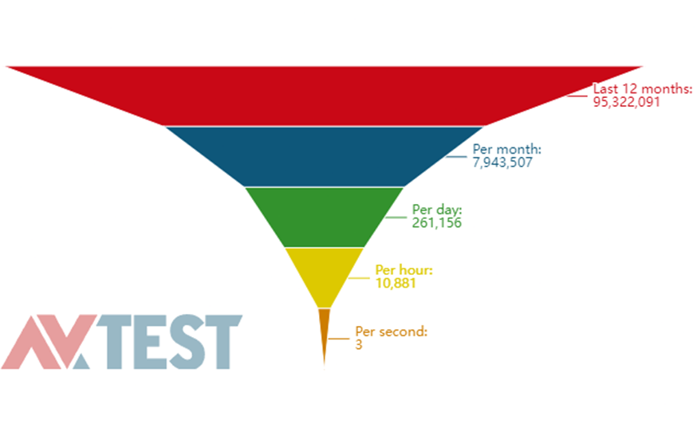


Motivation: Malware – Analysis - Detection
source: www.av-test.org/

Slide 3
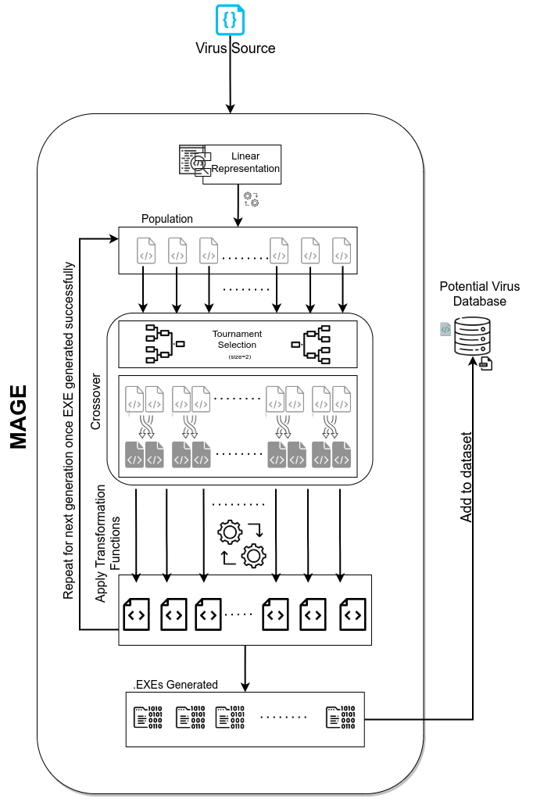
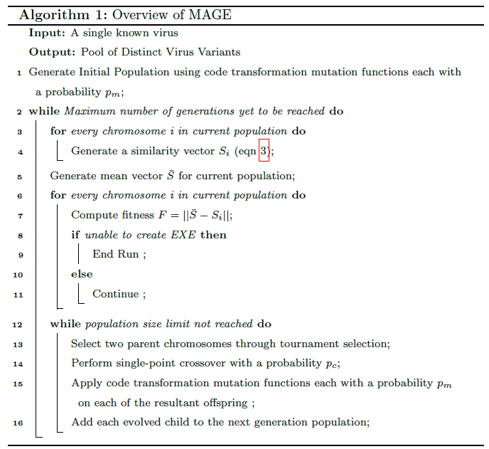
Malware Antigen Generating Evolutionary algorithm

Slide 4
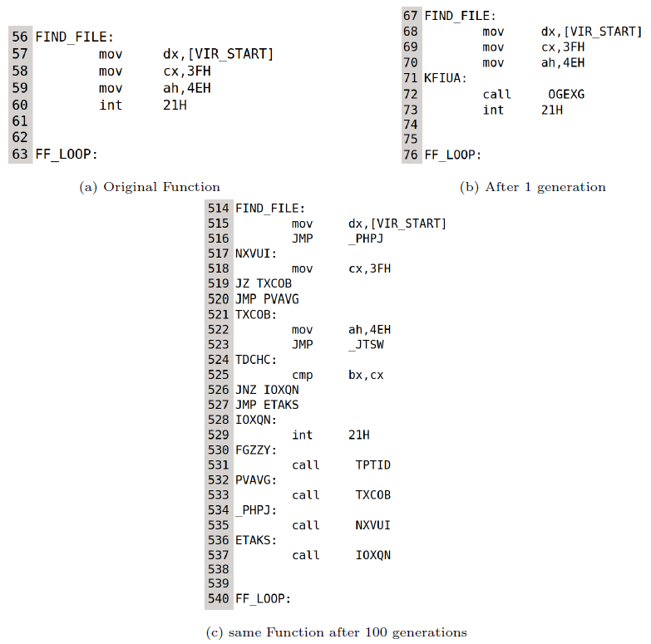
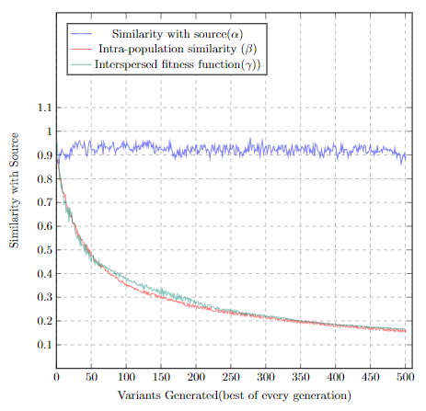
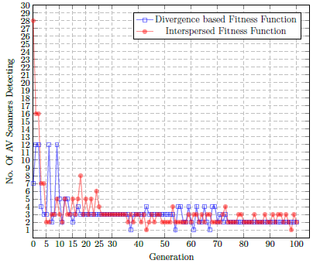
Outcome
Complexity
Maliciousness
Diversity

Slide 5

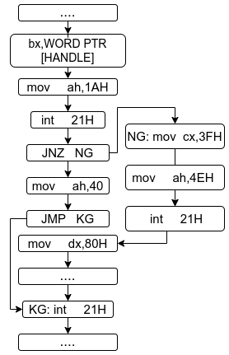
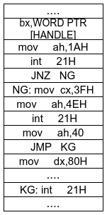
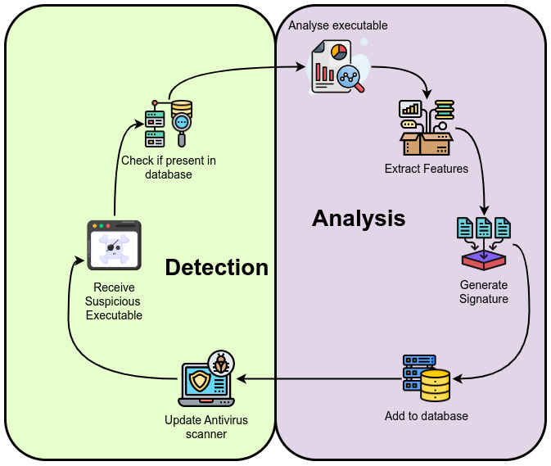
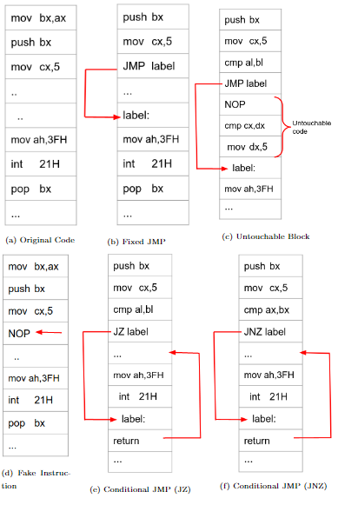
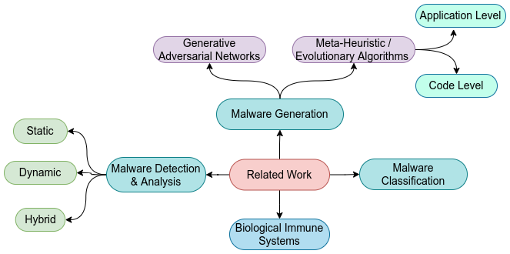
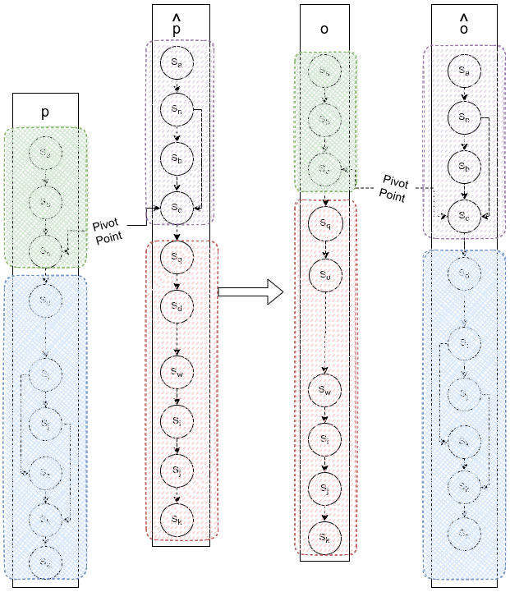
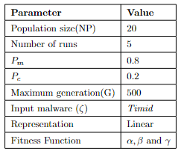
Summary of our Approach
Linear
Graph
Representation

Slide 6
Why our entry is Unique!
There are 4 reasons

Slide 7
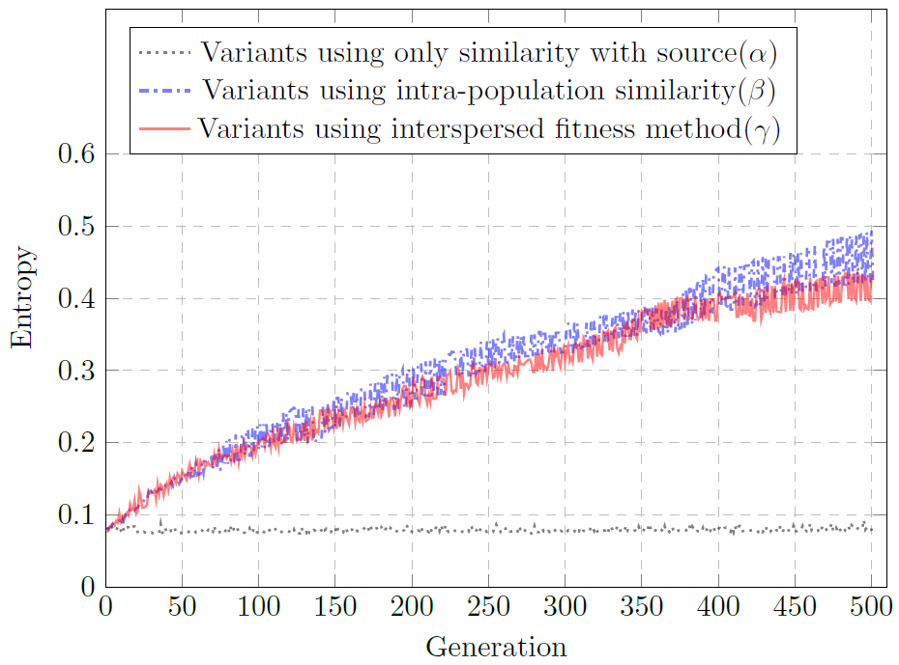
Reason 1: MAGE automatically evolves structurally diverse yet behaviorally intact malware variants
Comparision of Fitness Measures
Fitness Measure | Mean Similarity (smaller is better) | Mean Entropy (larger is better) | Mann Whitney U Test Result
α* | 0.923645 | 0.077785 | Same
β | 0.271541 | 0.319802 | Diverse
γ | 0.280414 | 0.298603 | Diverse
*Adapted from (Castro et al., 2019)
Novelty search-based approach is optimal
Over 34,420 successful virus variants generated in under 2 hours

Slide 8
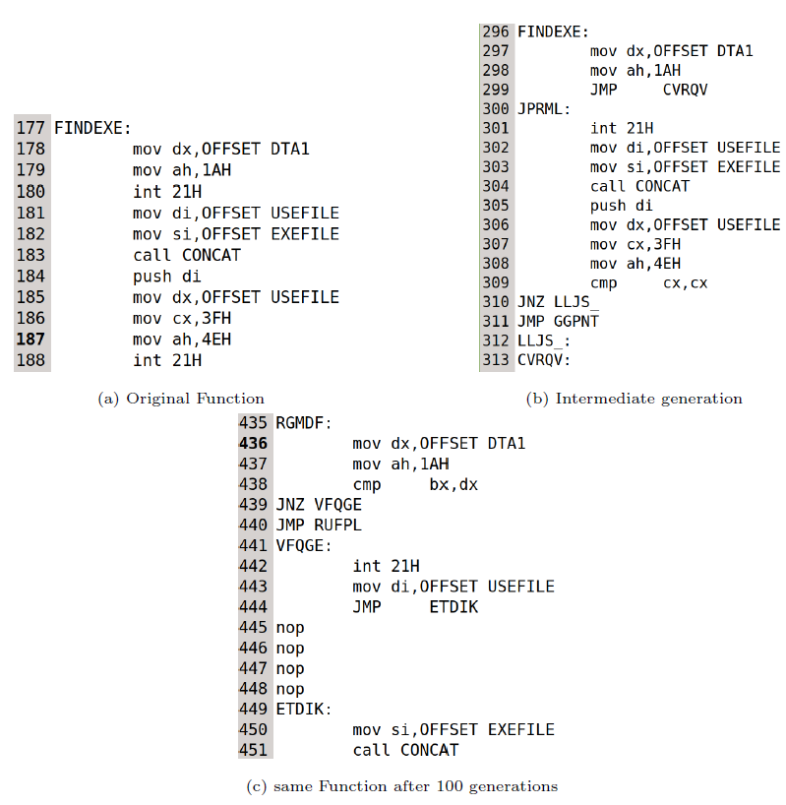
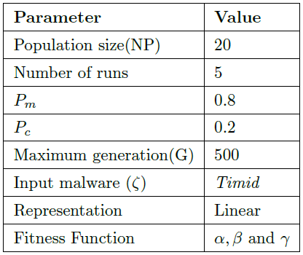
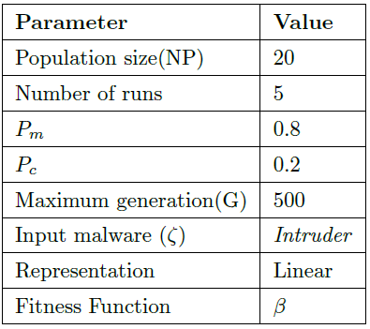
Reason 2: MAGE Evolves complex code structures that are well beyond human capacity

Slide 9
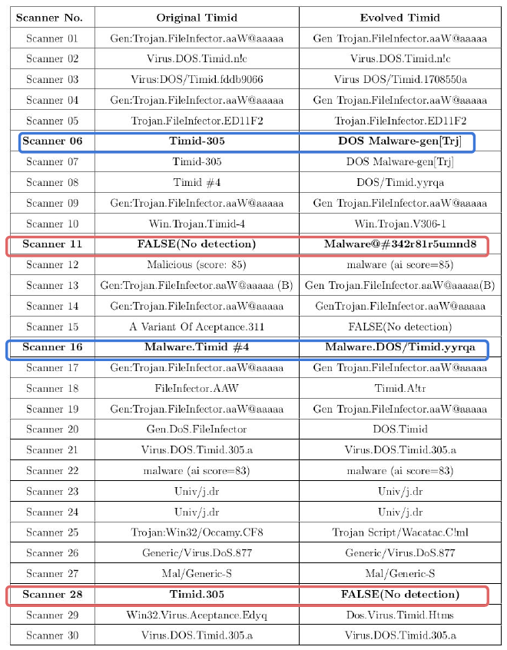
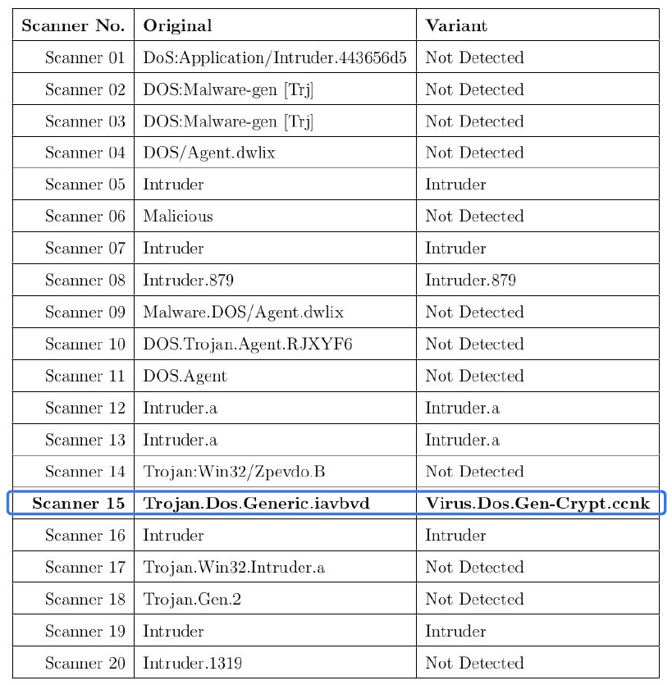
Reason 3: Evolved divergent variants which were misclassified by the antivirus scanners

Slide 10
Reason 4: MAGE Evolves malware variants (through code transformation functions) that result in a valid executable.
Able to evolve variants successfully for over 1700 generations
At 20 candidates per generation, this implies 1721×20 = 34,420 valid malware executables.
500 generations in under 30 minutes

Slide 11
Therefore, our result:
is equal to or better than a result that was accepted as a new scientific result at the time when it was published in a peer-reviewed scientific journal (B),
is publishable in its own right as a new scientific result — independent of the fact that the result was mechanically created (D),
is equal to or better than the most recent human-created solution to a long-standing problem (E),
Is equal to or better than a result that was considered an achievement in its field at the time it was first discovered (F),
solves a problem of indisputable difficulty in its field (G).

Slide 12
In Conclusion

Slide 13
Over and above what has been discussed so far
MAGE sets the foundation for automated diverse malware generation for proactive defense in Windows environments
Showcases the potential of automated evolution to generate antigens for antivirus systems.
Able to evolve complex code structures that are well beyond human capacity
The evolved malware variants (like biological antigens) have the potential to help improve adaptive antivirus engines to achieve active acquired immunity against unseen variants of a given malware.
Modular
Generating malware variant datasets.

Slide 14
Thank you

